Slide 1
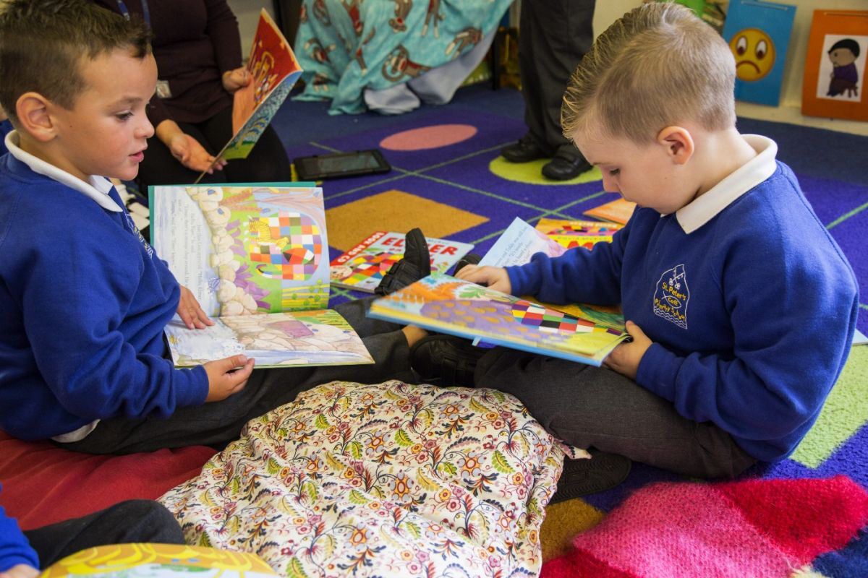
Independent Reading Time
A key element of a reading for pleasure pedagogy
© 1985 Anthony Browne
From WILLY THE CHAMP by Anthony Browne
Reproduced by kind permission of Walker Books Ltd

Slide 2
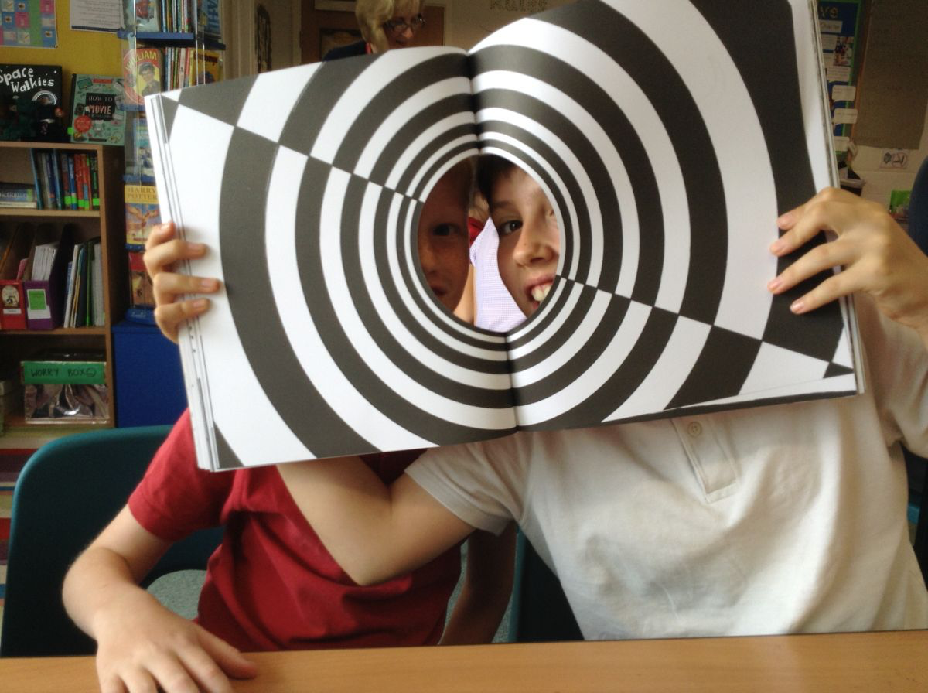
Aims
Consider our own experiences of reading
Review our practice
Share and develop ideas for independent reading time
Plan ways forward to enrich this time.

Slide 3
Key findings from Teachers as Readers
In order to effectively develop children’s RfP, teachers need to develop:
Knowledge of children’s literature and other texts
Knowledge of children’s reading practices
An RfP pedagogy, encompassing:
social reading environments
reading aloud
independent reading time
informal book talk, inside-text talk and recommendations
As Reading Teachers - teachers who read and readers who teach
Reciprocal and interactive reading communities.
(Cremin et al., 2014)

Slide 4
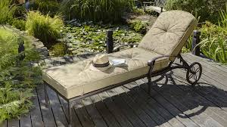
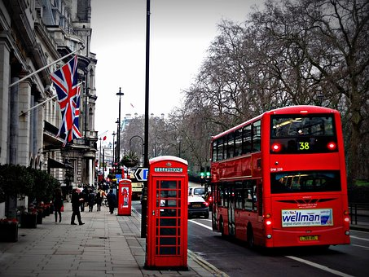
Your experience of reading for pleasure (volitional reading)
When do you RfP?
Where might you be?
What kinds of texts do you read?
Do you talk to others about what you read?

Slide 5
Can you name these acronyms?
ERIC
SQUIRT
USSR
OTTER
DEAR
Do they suit your Independent Reading time?

Slide 6
ERIC time: planned and timetabled
Review your practice
ERIC time | Frequency | Time allowed | Time slot
Reception
Year One
Year Two
Year Three
Year Six
Year Five
Year Six
Planning can help ensure entitlement for all.
Less experienced readers may not read much independently at home.
Readers need time to develop their interests and preferences, learning to persevere with different kinds of texts.
For further ideas to review current practice, see:
https://researchrichpedagogies.org/research/theme/independent-reading

Slide 7
Research suggests….
Independent reading time practices that support RfP are characterized by:
Informality, offering a relaxed, sustained time
Child ownership
Conversation about texts
Child choice of texts.
(Cremin et al., 2014; Gambrell, 2011; Skeeters, 2016)

Slide 8
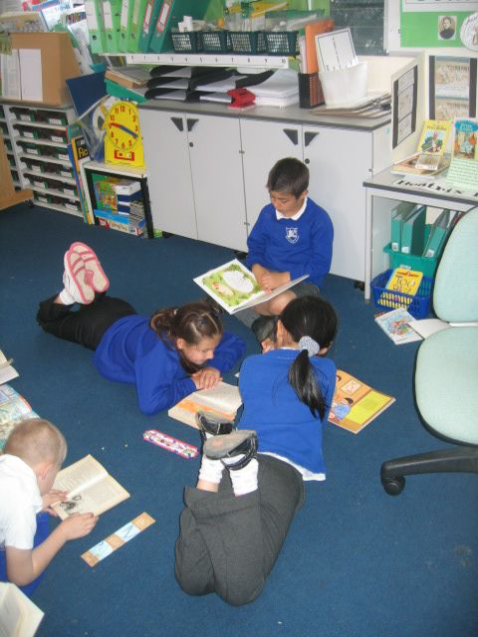
Informal, relaxed and sustained
Can they sit/lie where they like?
With whom they wish?
Do they sometimes
read silently?
read in pairs?
read aloud?
chat?
But The how best to organise and display them to tempt? **
tempt? **
Do you ever read outside?
Is your reading area used?
Is there enough time to get into a text and develop perseverance?

Slide 9
Child ownership of this time
Watch this classroom clip on supporting independent RT
What do you see as the key messages?
What might be challenges?
What might be benefits?
https://researchrichpedagogies.org/research/
theme/independent-reading

Slide 10
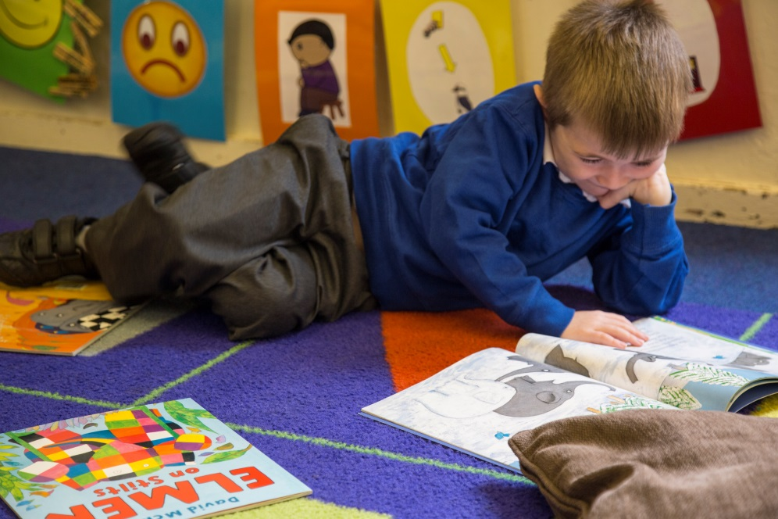
Talk as a critical part of independent reading
Possibilities
Two minutes at the start of ERIC e.g. Why did you choose it?
What do you think is going to happen?
Who is your favourite character?
Five minutes at the end of ERIC e.g.
What happened today in the story?
What fact interested you?
What picture was your favourite?
Would you recommend the text?
During ERIC e.g.
Sitting alongside children talking and joining in their conversation
NB
Avoid interrupting anyone reading
You could have a set space for those who wish to be silent that day.
Discuss the time and space in school that children have to talk about what they read in assigned reading time and at home.

Slide 11
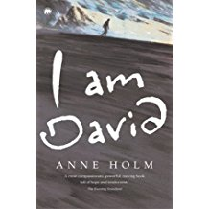
Child choice of texts
Can they choose from anywhere?
What kinds of texts do individuals tend to choose?
Do you document this?
Is the range tempting and broad enough?

Slide 12
Helping children to make their choices
Watch this classroom clip – does the curved ball work for you too?
https://researchrichpedagogies.org/research/theme/independent-reading

Slide 13
Classroom implications
Now there is ERIC own reading time… this has gone to 10 to 15 minutes every day at least. This has prompted more book talk and informal recommendations.
(TaRs teacher, Medway)
I thought they’d mess about if I gave them more choice about what they can do, but it hasn't turned out like that- providing that they have books that motivate them- that seems to be key.
(TaRS teacher Birmingham)
We vary it now, some days I allow talk, other times I insist on quiet. It surprises me that the talk is about books!!
(TaRs teacher Barking and Dagenham)
Notes:
13
13

Slide 14
Planning ahead: Developing independent reading time
Which aspects do you want to develop?
Informality with sustained time to read
Child ownership
Talk as a crucial part
Child choice of texts

Slide 15
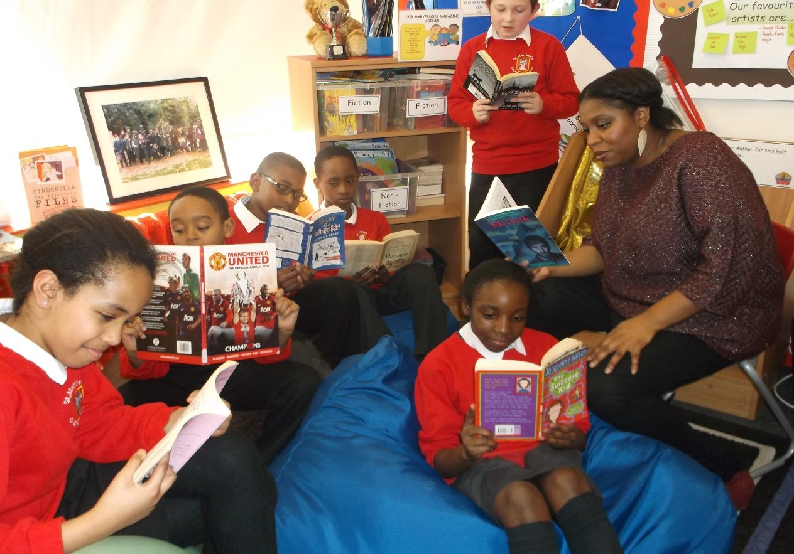
Do consider sharing your development work on the RfP site
https://researchrichpedagogies.org

Slide 16
References
Cremin, T., Mottram, M., Collins, F., Powell, S. and Safford, K. (2014). Building Communities of Engaged Readers: Reading for pleasure. London and NY: Routledge.
Gambrell, L. (2011) Seven Rules of Engagement: What’s most important to know about motivation to read Reading Teacher, 65(3):172-178.
Skeeters,K. et al., (2016) The Top Five Reasons we love giving students choice in reading English Leadership Quarterly 38(3) 6-7.

