Slide 1
Encountering vocabulary challenges in texts
­
Supporting all readers in secondary schools
Joanna Kenyon
May 2025
Final version

Slide 2
Overview
This document contains…
Slides that could be used as part of a CPD sequence for teachers in school, supporting understanding of reading in secondary schools
Points to consider when using this resource
The resources in this series are intended as a companion piece to the DfE’s series of training videos and guidance Supporting all readers in secondary school, providing additional detail. This resource expands on ideas shared in video 6, Exploring vocabulary and provides links to research.

Slide 3
Vocabulary knowledge
Reading and vocabulary knowledge: the most virtuous and positive of circles
Breadth of knowledge
Depth of knowledge
Types of vocabulary
Approaches to clarifying vocabulary
Most students need 12-20 exposures to a new word in different contexts to secure that word in their long-term memory.
Students encounter a much wider range of vocabulary when reading texts for study than in the planned content of the curriculum.
McKeown, M. G., Beck, I. L., Omanson, R. C., & Pople, M. T. (1985). Some Effects of the Frequency of Vocabulary Instruction on the Knowledge and Use of Words. Reading Research Quarterly, 20(5), 522-535

Slide 4
Elements of vocabulary knowledge
Receptive and expressive understanding
Exposure to words in a range of contexts
Use and meaning in context
Pronunciation
Strategies for clarifying unfamiliar words
Definition
Morphology
Etymology
Links and word families

Slide 5
Morphological and etymological knowledge – the keys to the kingdom
Prefixes
Suffixes
Root words
con- (together)
pro- (forward)
ab- (away from)
re- (back again)
de- (from, down from)
in- (in, into)
-or/-er (noun: someone who does)
-(t)ion (noun: the act, process or state of)
-ence (noun: action, state or quality)
duct (lead, take)
fer (bring, carry)
fac (do, make)
-ive (adjective: tending to, causing)
tract (drag, pull)

Slide 6
infrastructure
in | fra | struc | ture
Say it back to me “infrastructure” again “infrastructure”
infra – beneath, underneath struct – build ure – the result of a process
Infrastructure is the result of building all the things that under-pin daily life – water works, transport, electricity
infra-red, inferior, structural, construction, destructive
Vocabulary routines
Model pronunciation
Snip into syllables
Student repetition
Look at morphemes and explain meanings
Link to known words and contexts

Slide 7
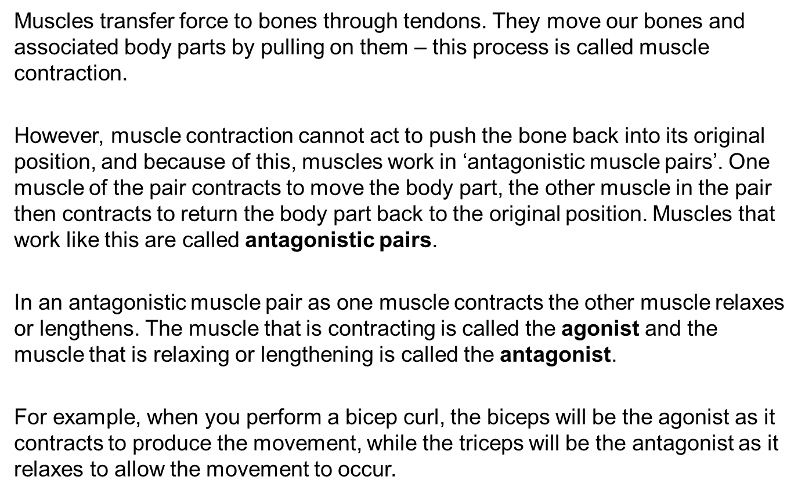
Antagonistic muscle pairs - Muscular system - Edexcel - GCSE Physical Education Revision - Edexcel - BBC Bitesize
Interestingly, texts used in PE theory include a wide range of challenging vocabulary and concepts. Most PE GCSE revision material is roughly pitched at a reading age of 15-17.
Vocabulary encounters in texts

Slide 8
Using vocabulary clarification routine for key words in context
Okay, we haven’t come across the word ‘antagonistic’ in this context before.
Let’s read that aloud a couple of times: ‘ant-ag-on-ist-ic’
Now you say it back to me, nice and loud.
There are some bits of the word that remind me of other words I know – ‘istic’ on the end of a word usually describes what something is like, as in artistic, realistic, so I’m thinking that this describes the muscle pair and gives you an idea of what it does.
I also think I recognise the bit at the beginning ‘ant’ – that sounds like ‘anti’, which means ‘against’ or ‘opposite’, so I’m thinking it means that the muscles in the pair are working against each other.
Has anyone heard the word ‘antagonistic’ in another context? Right, Liam, you’ve been told off for being antagonistic towards Mr Smith before. Were you going up against him? You were? Okay, so it seems like we’re on the right lines.
Fun fact: ‘agon’ in ancient Greek means ‘contest’ or ‘wrestling match’ so that works well here too – the antagonistic muscle pair are in a pulling contest with each other.
Another context you might hear the word antagonist in school is in English lit, when the antagonist is the person in conflict with the main character, who is often called the protagonist.
Now let’s re-read that section with full understanding of the key word.

Slide 9
Familiarise students with conventions of texts when they arise – share the clues that can be used to understand
Unfamiliar phrases can pose as many problems for comprehension as challenging vocabulary
Explicitly talk through the thinking process of an expert reader
‘Muscles transfer force to bones through tendons.’
I didn’t know what ‘transfer force to bones’ meant – that’s not how I think of it – but I notice that the explanation actually comes in the next sentence.
‘They move our bones and associated body parts by pulling on them – this process is called muscle contraction.’
That happens a lot when a text uses a key word or phrase that is a bit unfamiliar – it often explains what it means in the next sentence. Let’s check whether that happens again in the next paragraph. Yes it does – look, the bit about antagonistic muscle pairs. That’s worth looking out for again if you’re reading something that seems a bit tough. Don’t give up – just read the next sentence and see if it explains.

Slide 10
HIAS English Team
Please contact Joanna Kenyon Joanna.Kenyon@hants.gov.uk for support with secondary reading, whole school literacy and English.
For further details on the full range of services available please contact us using the following email: htlcdev@hants.gov.uk
Upcoming Courses
Keep up-to-date with our learning opportunities for each subject through our Upcoming Course pages linked below. To browse the full catalogue of learning offers, visit our new Learning Zone. Full details of how to access the site to make a booking are provided here.
English
Maths
Science
Geography
RE
History
Leadership
Computing
Art
D&T
Assessment
Support Staff
SEN
TED
MFL

Slide 11
Terms and conditions
Terms of use
This file is for personal or classroom use only. By using it, you agree that you will not copy or reproduce this file except for your own personal, non-commercial use. HIAS have the right to modify the terms of this agreement at any time; the modification will be effective immediately and shall replace all prior agreements.
You are welcome to:
download this resource
save this resource on your computer
print as many copies as you would like to use in your school
amend this electronic resource so long as you acknowledge its source and do not share as your own work.
You may not:
claim this resource as your own
sell or in any way profit from this resource
store or distribute this resource on any other website or another location where others are able to electronically retrieve it
email this resource to anyone outside your school or transmit it in any other fashion.

