Slide 1
Understanding how we develop as readers
­
Supporting all readers in the secondary school
Joanna Kenyon
May 2025
Final version

Slide 2
Overview
This document contains…
Slides that could be used as part of a CPD sequence for teachers in school, supporting understanding of reading in secondary schools
Points to consider when using this resource
The resources in this series are intended as a companion piece to the DfE’s series of training videos and guidance Supporting all readers in secondary school, providing additional detail. This resource expands on ideas shared in video 2, What is reading? and provides links to research.

Slide 3
Language
comprehension
processes
The simple view of reading
Language comprehension includes:
vocabulary knowledge
the ability to follow a line of argument or narrative
the ability to draw inferences and make connections between pieces of information and background knowledge
making sense of spoken and written language
Word recognition includes:
decoding using phonics
recognition of words at sight – automaticity
accuracy in reading
Good language comprehension
poor decoding
Good language comprehension
good decoding
G
o
o
d
Word
recognition skills
Poor
Good
Word
recognition skills
P
o
o
r
Poor decoding
poor language comprehension
Good decoding
poor language comprehension
Language
comprehension
processes
Hoover, W. A., & Gough, P. B. (1990). The simple view of reading. Reading and Writing: An Interdisciplinary Journal, 2(2), 127–160

Slide 4
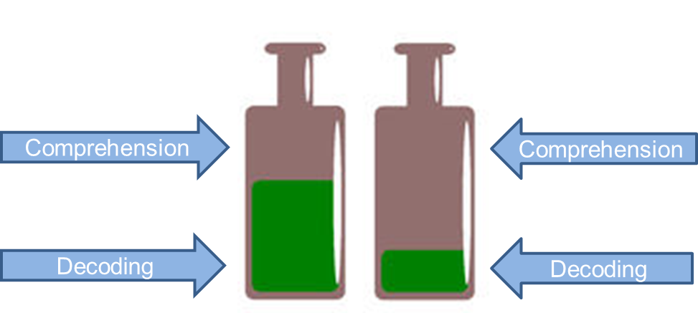
Perfetti et al.’s ‘decoding bottleneck’
For the first person, it takes a lot of effort to decode the text and as a result they have less ‘space’, (or processing capacity) to spend on trying to make sense of it.
This is what Perfetti et al. mean by a decoding bottleneck’. For the second person, decoding the text has been a relatively easy task and they have more available resources to comprehend it.
Perfetti, C. A., & Lesgold, A. M. (1977). Coding and Comprehension in Skilled Reading and Implications for Reading Instruction. In L. B. Resnick & P. Weaver (Eds.), Theory and Practice in Early Reading. Hillsdale, NJ: Lawrence Erlbaum Associates
ed145399.tif.pdf

Slide 5
Scarborough’s reading rope
Hollis Scarborough’s reading rope metaphor breaks down the elements of language comprehension and word recognition further, using the image of braided and twisted strands to show how intertwined the elements of effective reading are.
In general terms, most pupils should secure the red strands during KS1, while the green strands continue to be developed increasingly strategically across KS2 and beyond.
Scarborough, H. S. (2001). Connecting early language and literacy to later reading (dis)abilities: Evidence, theory, and practice. In S. Neuman & D. Dickinson (Eds.), Handbook of Early Literacy Research (pp. 97-110). New York: Guilford Press
AA ABOUT THE ROPE Final.pptx

Slide 6
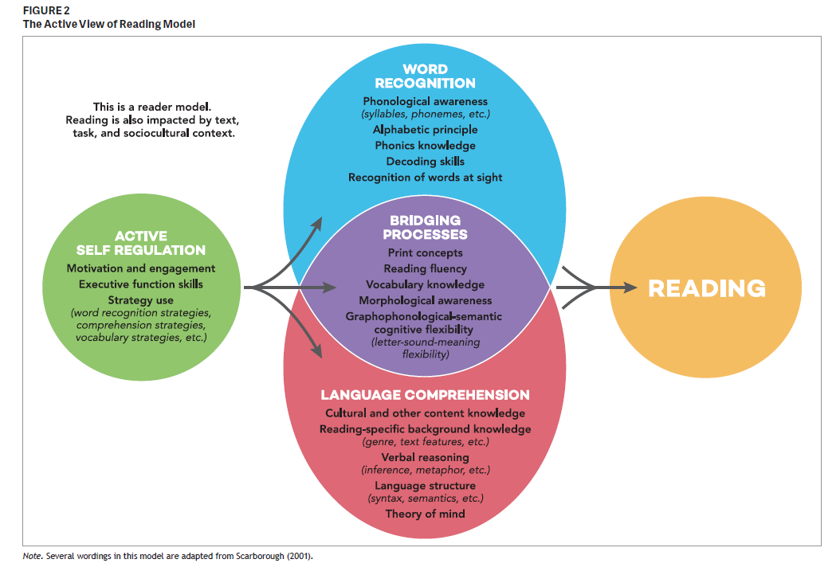
The active view of reading
Building on the Simple View of Reading, Duke and Cartwright’s work (2021) also emphasises the importance of executive function skills such as attention, monitoring own understanding and self-regulation, as well as motivation and engagement in developing reading.
The bridging processes identified are helpful to focus on in supporting pupils to improve their reading.
Duke, N. K., & Cartwright, K. B. (2021). The science of reading progresses: Communicating advances beyond the simple view of reading. Reading Research Quarterly, 56(S1), S25–S44. https://doi.org/10.1002/rrq.411
The science of reading progresses: Communicating advances beyond the simple view of reading.

Slide 7
HIAS English Team
Please contact Joanna Kenyon Joanna.Kenyon@hants.gov.uk for support with secondary reading, whole school literacy and English.
For further details on the full range of services available please contact us using the following email: htlcdev@hants.gov.uk
Upcoming Courses
Keep up-to-date with our learning opportunities for each subject through our Upcoming Course pages linked below. To browse the full catalogue of learning offers, visit our new Learning Zone. Full details of how to access the site to make a booking are provided here.
English
Maths
Science
Geography
RE
History
Leadership
Computing
Art
D&T
Assessment
Support Staff
SEN
TED
MFL

Slide 8
Terms and conditions
Terms of use
This file is for personal or classroom use only. By using it, you agree that you will not copy or reproduce this file except for your own personal, non-commercial use. HIAS have the right to modify the terms of this agreement at any time; the modification will be effective immediately and shall replace all prior agreements.
You are welcome to:
download this resource
save this resource on your computer
print as many copies as you would like to use in your school
amend this electronic resource so long as you acknowledge its source and do not share as your own work.
You may not:
claim this resource as your own
sell or in any way profit from this resource
store or distribute this resource on any other website or another location where others are able to electronically retrieve it
email this resource to anyone outside your school or transmit it in any other fashion.

