Slide 1
Tiered vocabulary
­
Supporting all readers in secondary schools
Joanna Kenyon
May 2025
Final version

Slide 2
Overview
This document contains…
Slides that could be used as part of a CPD sequence for teachers in school, supporting understanding of reading in secondary schools
Points to consider when using this resource
The resources in this series are intended as a companion piece to the DfE’s series of training videos and guidance Supporting all readers in secondary school, providing additional detail. This resource expands on ideas shared in video 6, Exploring vocabulary and provides links to research.

Slide 3
Tiered vocabulary
Familiar by now to the majority of teachers, Isabel Beck, Margaret McKeown and Linda Kucan’s work classifying vocabulary into tiers is set out in their book Bringing Words to Life (2002).
Both tier 2 and tier 3 vocabulary require explicit teaching:
Tier 3 teaching focuses on subject terminology in context
Tier 2 teaching focuses on academic vocabulary and broadening vocabulary applications between subjects; developing tier 2 vocabulary has rapid impact on vocabulary knowledge and the sophistication of students’ oral and written work.
Some students may have gaps in what we would perceive as tier 1 vocabulary at secondary level and these students are likely to need additional support.

Slide 5
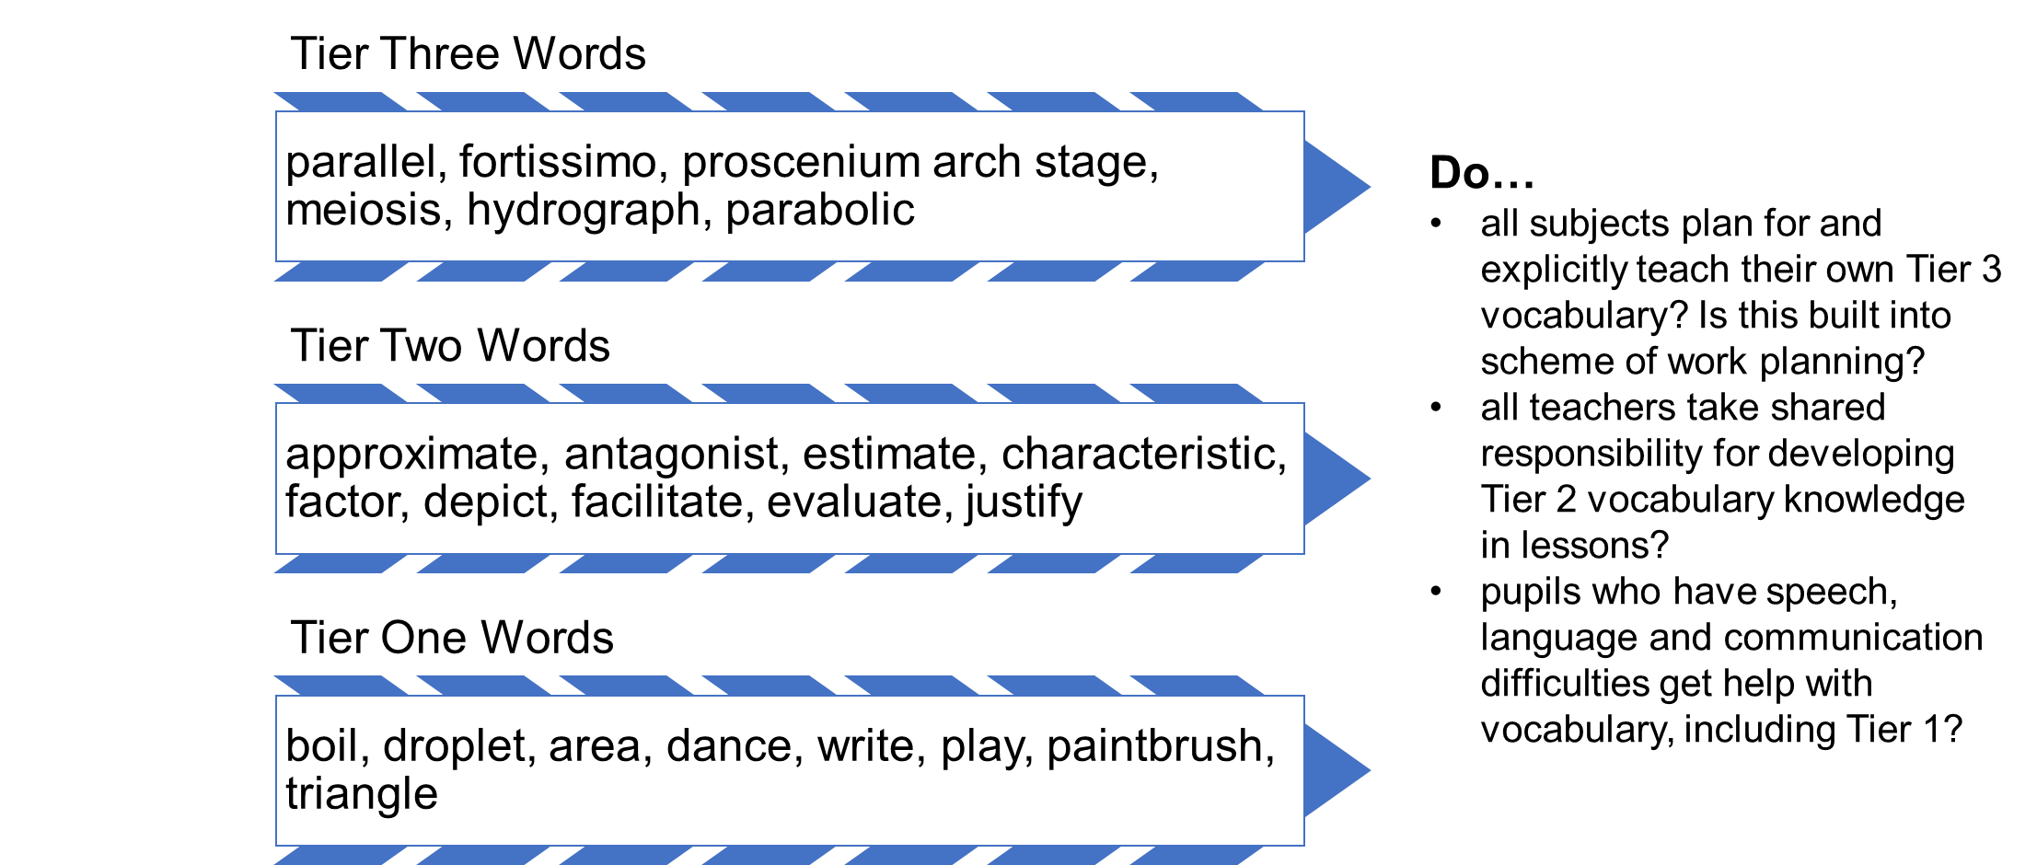

Slide 6
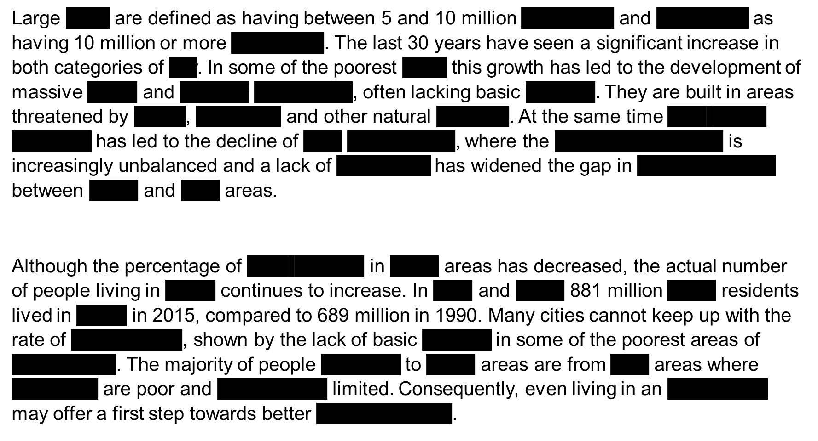
In this extract, the geographical terms have been removed. These are a mixture of tier 1 words (eg ‘cities’) and tier 3 terminology.
Tier 3 vocabulary is likely to be a key element of the curriculum and therefore will be planned for, taught explicitly and secured through retrieval.
However, the range of tier 3 vocabulary found in texts is likely to be larger than that planned into the curriculum and therefore exposure to texts is crucial in building vocabulary knowledge.
Tier 3 vocabulary

Slide 7
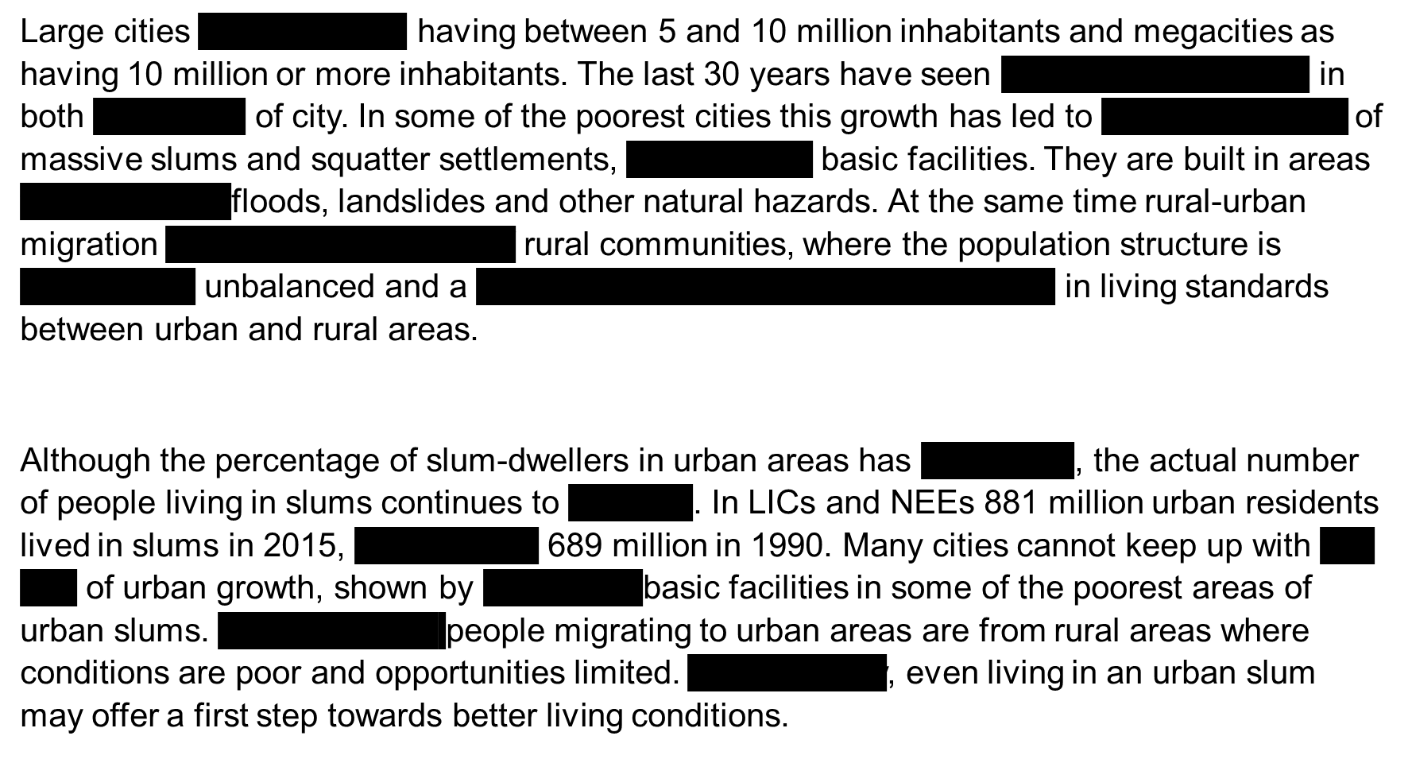
In this extract, the gaps are the tier 2 vocabulary that establishes an academic tone and could be used in other areas of the curriculum.
Exploring this type of vocabulary both through texts and through explicit teaching is also crucial to students’ comprehension of texts. It is often harder to use the clues from the context of the text to work out the missing tier 2 words than the missing tier 3 vocabulary, demonstrating the need to plan an approach to this vocabulary.
Tier 2 vocabulary

Slide 8
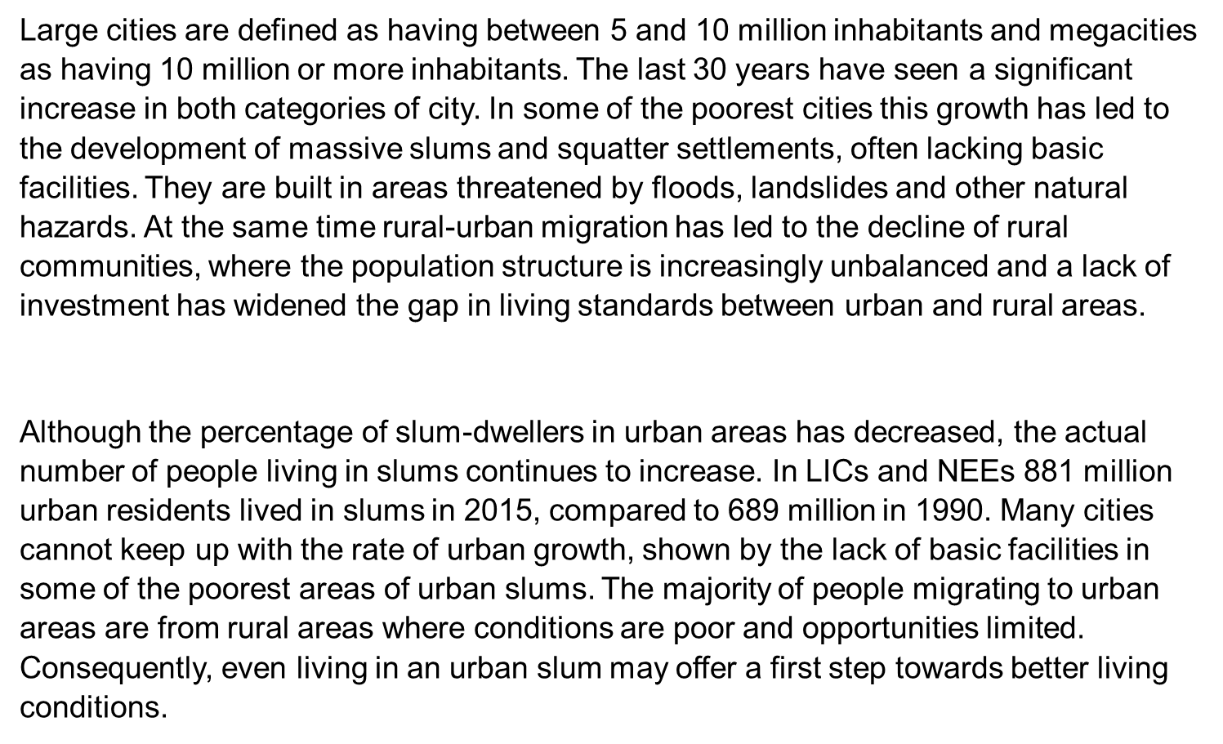
Compare the two versions with gaps. If pupils had been studying urban development in geography lessons, which vocabulary would prove more of a barrier to understanding the text if it was unfamiliar to students?
Full text, for reference

Slide 9
HIAS English Team
Please contact Joanna Kenyon Joanna.Kenyon@hants.gov.uk for support with secondary reading, whole school literacy and English.
For further details on the full range of services available please contact us using the following email: htlcdev@hants.gov.uk
Upcoming Courses
Keep up-to-date with our learning opportunities for each subject through our Upcoming Course pages linked below. To browse the full catalogue of learning offers, visit our new Learning Zone. Full details of how to access the site to make a booking are provided here.
English
Maths
Science
Geography
RE
History
Leadership
Computing
Art
D&T
Assessment
Support Staff
SEN
TED
MFL

Slide 10
Terms and conditions
Terms of Use
This file is for personal or classroom use only. By using it, you agree that you will not copy or reproduce this file except for your own personal, non-commercial use. HIAS have the right to modify the terms of this agreement at any time; the modification will be effective immediately and shall replace all prior agreements.
You are welcome to:
download this resource
save this resource on your computer
print as many copies as you would like to use in your school
amend this electronic resource so long as you acknowledge its source and do not share as your own work.
You may not:
claim this resource as your own
sell or in any way profit from this resource
store or distribute this resource on any other website or another location where others are able to electronically retrieve it
email this resource to anyone outside your school or transmit it in any other fashion.

