Slide 1
The importance of background knowledge in reading
­
Supporting all readers in the secondary school
Joanna Kenyon
May 2025
Final version

Slide 2
Overview
This document contains…
Slides that could be used as part of a CPD sequence for teachers in school, supporting understanding of reading in secondary schools
Points to consider when using this resource
The resources in this series are intended as a companion piece to the DfE’s series of training videos and guidance Supporting all readers in secondary school, providing additional detail. This resource expands on ideas shared in video 7, Activating background knowledge and provides links to research.

Slide 3
The importance of background knowledge
Knowledge of the world
In this example, shared by Daniel T Willingham in Why Don’t Students Like School?, the reader brings a huge amount of real-world knowledge to their understanding of the situation:
Beds have bouncy mattresses
Trampolines are toys for bouncing on
Children like bouncing
Children are sometimes disobedient
Bouncing on beds causes knocking on the floor
In an apartment building or block of flats, knocking on the floor disturbs downstairs neighbours
Flats are often rented rather than owned
A building manager runs blocks of flats (USA specific)
Renters can be evicted or asked to move
“I can’t convince my boys that their beds aren’t trampolines. The building manager is pressuring us to move to the ground floor.”
Willingham, D. T. (2009). Why Don't Students Like School?: A Cognitive Scientist Answers Questions About How the Mind Works and What It Means for the Classroom. Jossey-Bass

Slide 4
Background knowledge
Personal experiences
Understanding of human nature and emotions
What we have seen
What we have done
Where we have been
What prior knowledge we have of the topic
What we have studied
What similar texts we have read
What we can visualise
What connections we can make

Slide 5
Positioning reading within sequences
More challenging texts can be placed effectively towards the end of a sequence of teaching once pupils have:
secured understanding of the main concepts
seen visual images or had experience of physical processes linked to the key content
secured vocabulary knowledge relevant to the content
More straightforward texts can be used effectively to introduce a topic or with a higher requirement for independent reading

Slide 6
Background knowledge and knowledge of vocabulary
Subject-specific texts are often filled with the terminology used by experts. There is often a significant crossover between vocabulary knowledge and content knowledge.
Check the vocabulary and concepts that pupils need to be familiar with – frequently tier 3 vocabulary
Provide glossaries or illustrations of key terms
Use diagrams and teacher explanation to provide enough clarity to make sense of the text.

Slide 7
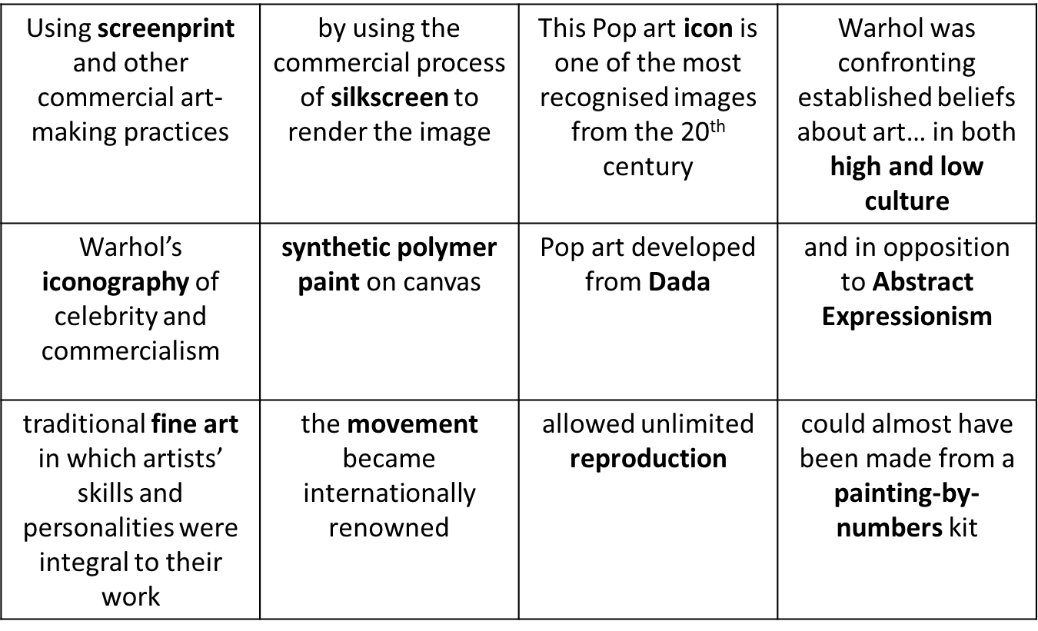
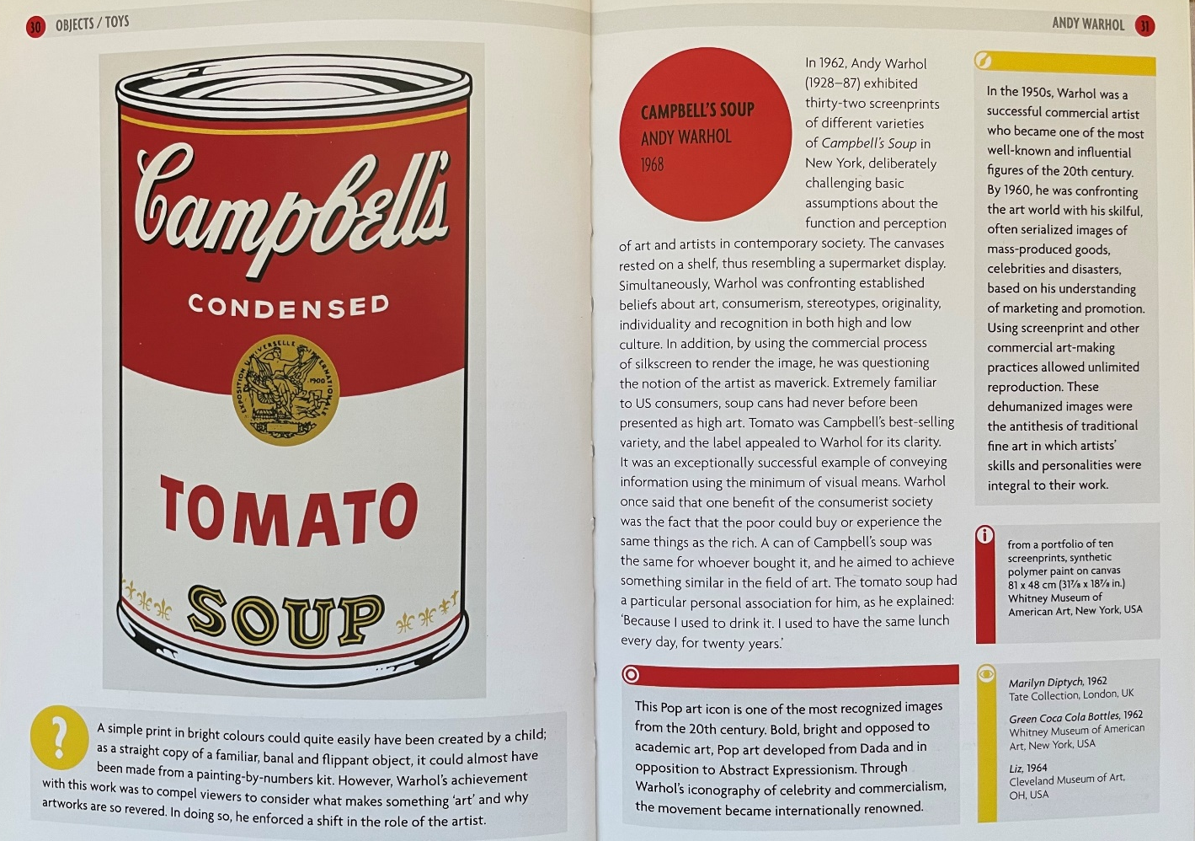
For example:
If reading about Andy Warhol’s artwork in a book that assumes some knowledge of art, students would benefit from some or all of the following knowledge:
images of Warhol’s work, especially the pieces referenced in the text
understanding of the processes of production used by Warhol, such as screenprinting
where and when Warhol was working, and what the references to popular culture that he uses link to (eg the celebrities portrayed in his images)
The vocabulary grid prepared provides prompts for much of this material.
This challenging text would work well after a unit studying Warhol’s work.
Hodge, S. (2012). Why Your Five-Year-Old Could Not Have Done That: Modern Art Explained. Prestel Publishing

Slide 8
Background knowledge for literature
Consider carefully how much background knowledge is required prior to reading a literary text: often, the necessary information is included in the text itself as part of the writer’s world building.
Students need to grow comfortable in making sense of unseen texts, making connections between details in order to understand literary texts.
Background knowledge of the historical and social context of texts is often crucial, but does not need to be front-loaded and can be introduced at points when it will illuminate the text itself. Values of the context both of the setting and the writing of the text can and should be inferred from the content and language of the text as pupils engage with the writer’s ideas.
Students rarely come to any literary text with no relevant knowledge – keep an open mind about what students bring to the reading conversation from their own relationships, experiences, other reading, popular culture etc
Provide prompts for thinking and connections, particularly visual prompts, rather than assuming that pupils need a long introduction full of factual content.

Slide 9
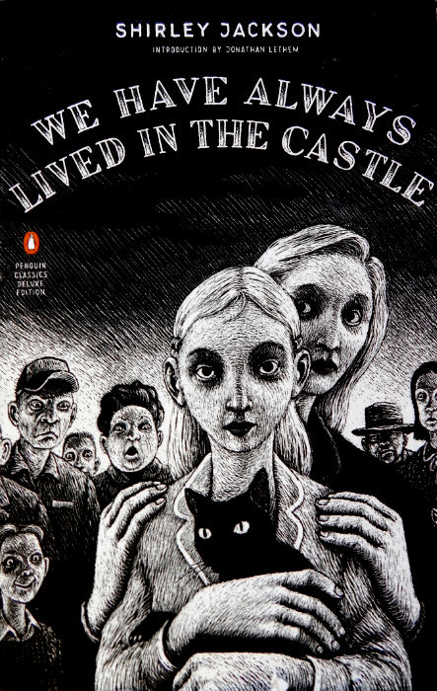
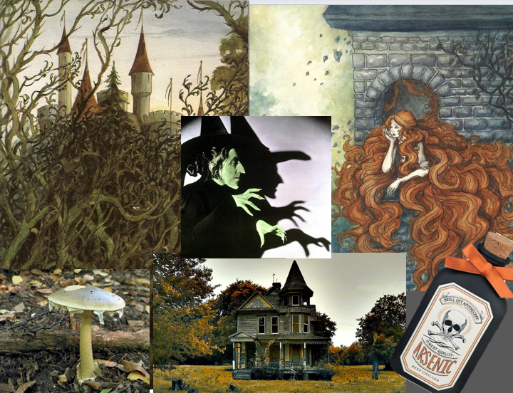
My name is Mary Katherine Blackwood. I am eighteen years old, and I live with my sister Constance. I have often thought that with any luck at all I could have been born a werewolf, because the two middle fingers on both my hands are the same length, but I have had to be content with what I had. I dislike washing myself, and dogs, and noise. I like my sister Constance, and Richard Plantagenet, and Amanita phalloides, the death-cap mushroom. Everyone else in my family is dead.
For example:
Priming students to think about their prior knowledge of witches, castles, isolation and poisons might be useful as a warm-up for reading this text.

Slide 10
HIAS English Team
Please contact Joanna Kenyon Joanna.Kenyon@hants.gov.uk for support with secondary reading, whole school literacy and English.
For further details on the full range of services available please contact us using the following email: htlcdev@hants.gov.uk
Upcoming Courses
Keep up-to-date with our learning opportunities for each subject through our Upcoming Course pages linked below. To browse the full catalogue of learning offers, visit our new Learning Zone. Full details of how to access the site to make a booking are provided here.
English
Maths
Science
Geography
RE
History
Leadership
Computing
Art
D&T
Assessment
Support Staff
SEN
TED
MFL

Slide 11
Terms and conditions
Terms of use
This file is for personal or classroom use only. By using it, you agree that you will not copy or reproduce this file except for your own personal, non-commercial use. HIAS have the right to modify the terms of this agreement at any time; the modification will be effective immediately and shall replace all prior agreements.
You are welcome to:
download this resource
save this resource on your computer
print as many copies as you would like to use in your school
amend this electronic resource so long as you acknowledge its source and do not share as your own work.
You may not:
claim this resource as your own
sell or in any way profit from this resource
store or distribute this resource on any other website or another location where others are able to electronically retrieve it
email this resource to anyone outside your school or transmit it in any other fashion.

