Slide 1
The challenge jump between primary and secondary
­
Supporting all readers in the secondary school
Joanna Kenyon
May 2025
Final version

Slide 2
Overview
This document contains…
Slides that could be used as part of a CPD sequence for teachers in school, supporting understanding of reading in secondary schools
Points to consider when using this resource
The resources in this series are intended as a companion piece to the DfE’s series of training videos and guidance Supporting all readers in secondary school, providing additional detail. This resource expands on ideas shared in video 3, Reading in secondary students and provides links to research.

Slide 3
The reading gap between primary and secondary school
Learning to read for comprehension
Reading comprehension for learning
Challenging academic curriculum
Focus on subject disciplinary content
Increased reading demands of texts in use
Teachers may have limited literacy training
Different approaches to reading in different subjects

Slide 4
Examples of texts and questions from KS2 papers
This is an example of the most easily accessible level of text on the KS2 reading test papers. From the 2018 paper, this extract has a reading age of roughly 11-13 and is therefore generally intended to be accessible to most pupils; those pupils who pass the reading test are likely to have answered most of the questions on this text correctly.
Standards and Testing Agency. (2018). Key stage 2 tests: 2018 English reading test materials. Retrieved from 2018 key stage 2 English reading: Reading booklet

Slide 5
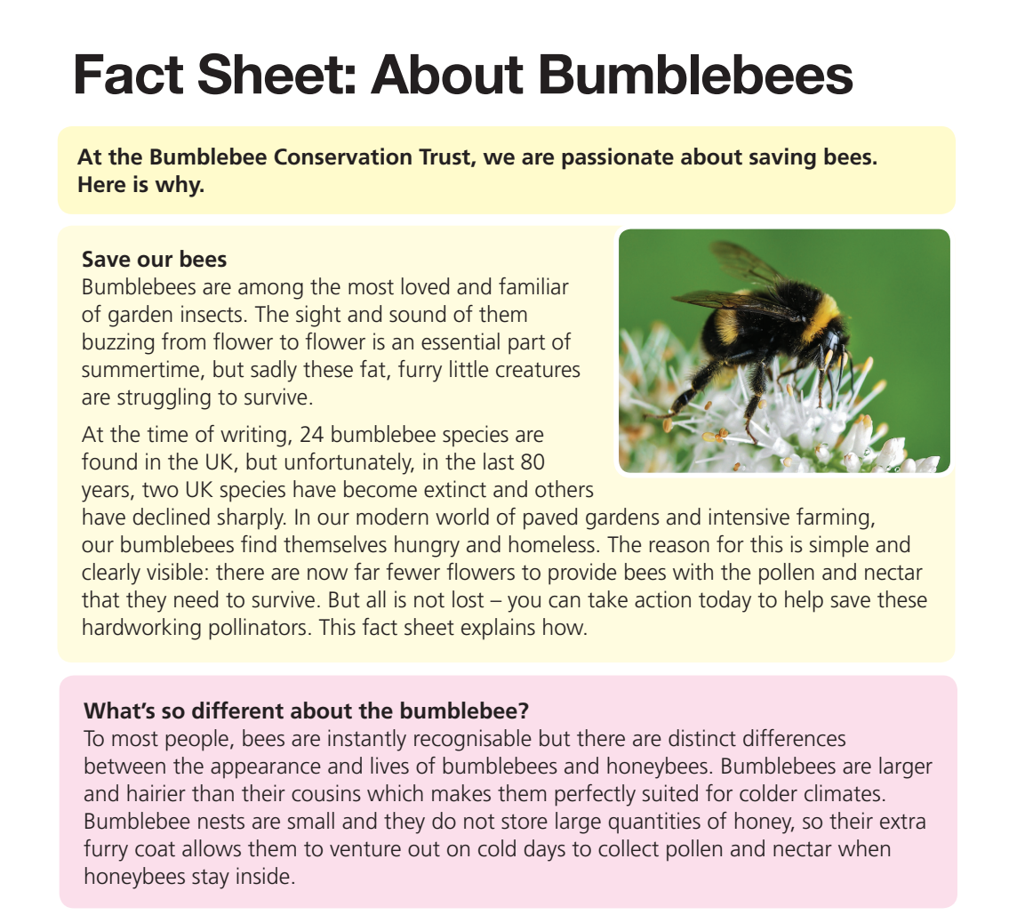
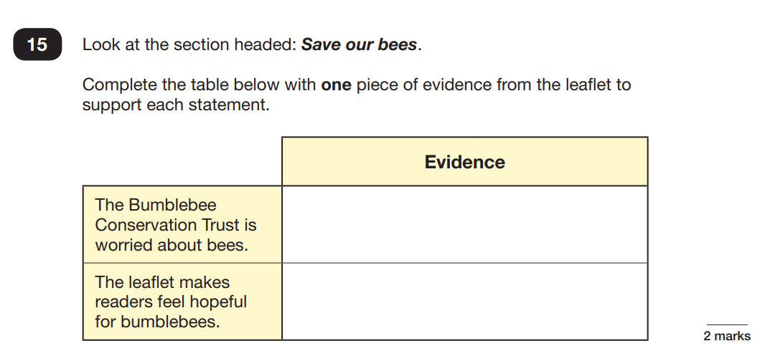
Examples of texts and questions from KS2 papers
Many pupils in 2019 found the questions on the extract about bumblebees fairly challenging. This text has a reading age of 13-14 years and was the second text on the paper, providing a reasonable level of challenge. Pupils who passed the test are likely to have answered at least half of these questions correctly, but even those who passed tended to find some questions difficult.
Standards and Testing Agency. (2019). Key stage 2 tests: 2019 English reading test materials. Retrieved from 2019 key stage 2 English reading booklet

Slide 6
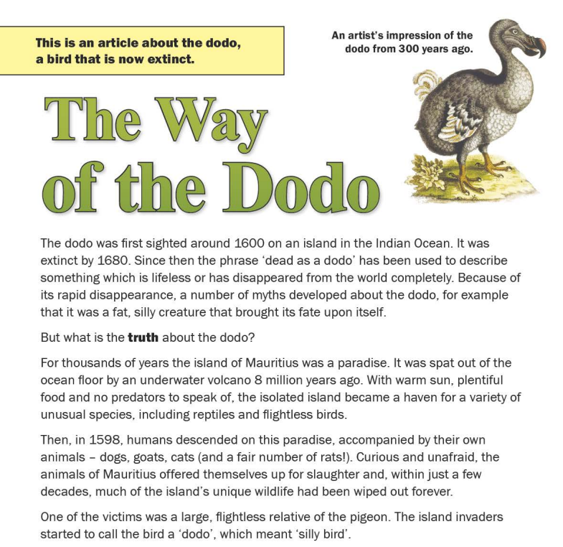
Examples of texts and questions from KS2 papers
Probably the most challenging text that has been included on a KS2 reading test and called out by many teachers for being too hard, The Way of the Dodo has a reading age of approximately 14-15 because of the complex vocabulary, the proportion of longer sentences, the lack of helpful organisational features such as subheadings and the requirement for a substantial amount of background knowledge. This was the third piece on the 2016 KS2 reading paper and was intended to provide stretch and challenge for the strongest readers. Many children will have only answered a proportion of the questions in this section and even those who achieved the higher standard in the test would not have expected to secure all the marks available.
Standards and Testing Agency. (2016). Key stage 2 tests: 2016 English reading test materials. Retrieved from 2016_ks2_Englishreading_readingbooklet_26012016_PDFA.pdf

Slide 8
Thinking about reading in the secondary school
There is limited difference between the reading ability (specifically, the ability to decode a text) of a Year 5 and a Year 8 pupil, and yet the expectation of reading for academic purposes is significantly higher as pupils move through secondary school.
Creating links between primary and secondary curricular approaches is a way to support pupils as they move through transition. This does not mean that pupils should not be asked to read challenging material within the curriculum for each subject.
It does mean:
Teachers need to think about the level of challenge of the texts that they want to use in the classroom and the level of support that pupils may need to access the text, particularly those pupils who struggle more with reading.
Teachers need to give class time to understanding the text itself before asking pupils to use the information within the text for academic purposes.

Slide 9
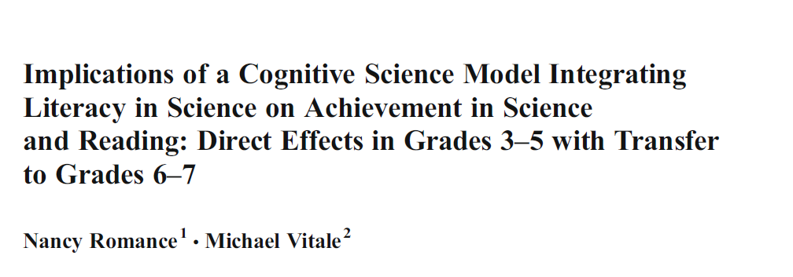
Curricular reading
Findings of the study:
Reading an appropriately challenging text about a topic being studied
and
using the information from the text in order to complete a task
leads to
improved understanding of the topic
and
improved reading
“A curricular approach integrating literacy within in-depth science instruction has the benefit of increasing student academic achievement in science and reading comprehension—on both a direct and transfer basis—in a far more effective manner than traditional reading/language arts programs”
Notes:
Works for any knowledge-based subject
English Lit – reading about an author or text; reading criticism, reading about a concept eg Freytag’s pyramid, narrative voice

Slide 10
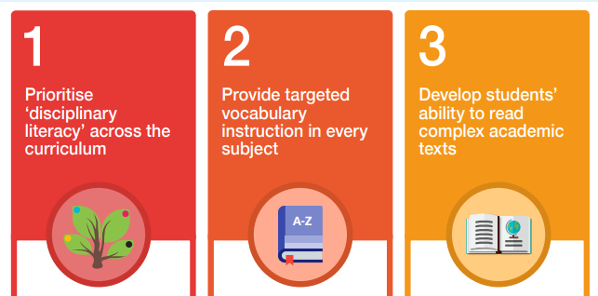
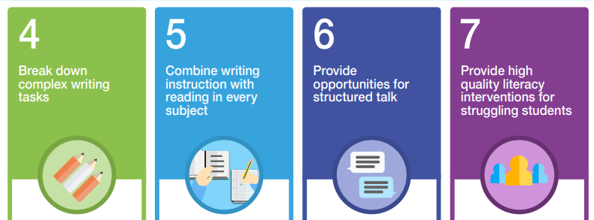
We want…
Students to be taught and supported to read complex text that will move them forward, both in their subject studies and in their reading
Teachers to include challenging reading material in their lessons
Plenty of opportunities to read challenging material in supportive and meaningful contexts in lessons, every day
EEF_KS3_KS4_LITERACY_GUIDANCE.pdf

Slide 11
HIAS English Team
Please contact Joanna Kenyon Joanna.Kenyon@hants.gov.uk for support with secondary reading, whole school literacy and English.
For further details on the full range of services available please contact us using the following email: htlcdev@hants.gov.uk
Upcoming Courses
Keep up-to-date with our learning opportunities for each subject through our Upcoming Course pages linked below. To browse the full catalogue of learning offers, visit our new Learning Zone. Full details of how to access the site to make a booking are provided here.
English
Maths
Science
Geography
RE
History
Leadership
Computing
Art
D&T
Assessment
Support Staff
SEN
TED
MFL

Slide 12
Terms and conditions
Terms of Use
This file is for personal or classroom use only. By using it, you agree that you will not copy or reproduce this file except for your own personal, non-commercial use. HIAS have the right to modify the terms of this agreement at any time; the modification will be effective immediately and shall replace all prior agreements.
You are welcome to:
download this resource
save this resource on your computer
print as many copies as you would like to use in your school
amend this electronic resource so long as you acknowledge its source and do not share as your own work.
You may not:
claim this resource as your own
sell or in any way profit from this resource
store or distribute this resource on any other website or another location where others are able to electronically retrieve it
email this resource to anyone outside your school or transmit it in any other fashion.

