Slide 1
Further active reading strategies for comprehension
­
Supporting all readers in secondary schools
Joanna Kenyon
May 2025
Final version

Slide 2
Overview
This document contains…
Slides that could be used as part of a CPD sequence for teachers in school, supporting understanding of reading in secondary schools
Points to consider when using this resource
The resources in this series are intended as a companion piece to the DfE’s series of training videos and guidance Supporting all readers in secondary school, providing additional detail. This resource expands on ideas shared in video 8, Teaching reading comprehension and provides links to research.

Slide 3
Think-Alouds – modelling the thinking behind the reading
A think-aloud is a way of capturing understanding of text, articulating ideas, questions, clarification of vocabulary, predictions while reading. This modelling approach supports children to understand the thought processes of a confident reader.
Davey, B. (1983). Think Aloud: Modeling the Cognitive Processes of Reading Comprehension. Journal of Reading, 27(1), 44-47

Slide 4
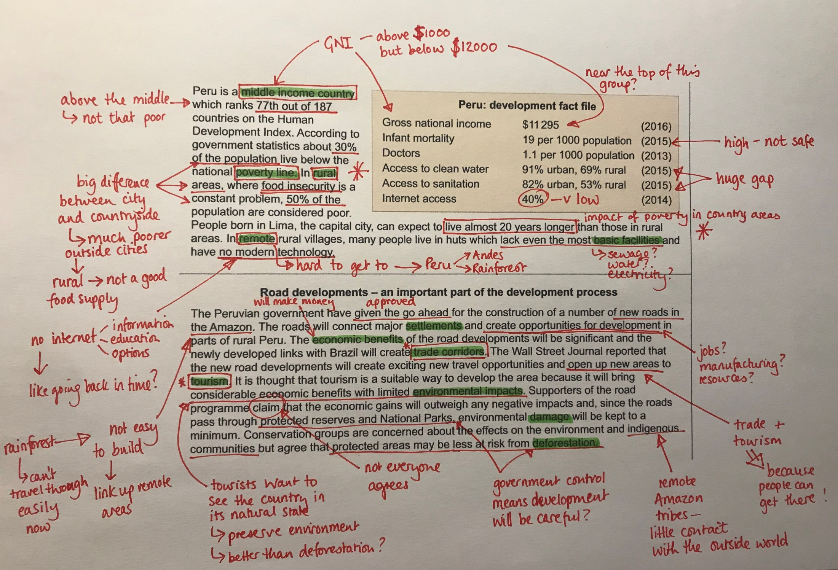
Annotations to show thought processes in a think-aloud approach
This example demonstrates the think-aloud process aimed at securing initial understanding using the pre-released material from an AQA Geography GCSE paper (2018). A more subject specific approach would be even more beneficial.
Accessed online
june-2018-paper-3-prerelease-materials-aqa-gcse-geo.pdf
Teachers should demonstrate the kind of disciplinary thinking and annotation that is required for the subject – students’ notes are often poor and do not support comprehension unless this process is modelled for them by an expert.

Slide 5
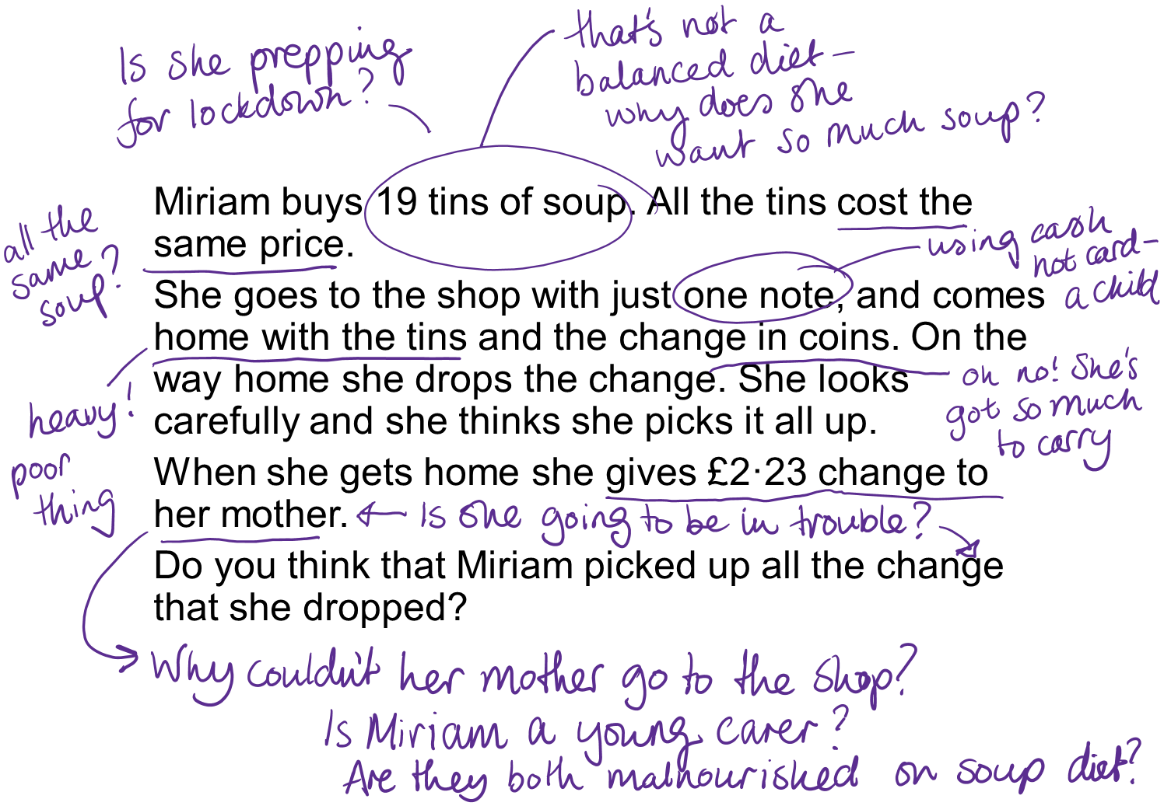
A think-aloud annotation approach can also reveal to the teacher the misconceptions held by the student.
This example includes the commentary made by a group of secondary school literacy leaders when asked to think-aloud around a maths problem aimed at Year 6 pupils.
Explicit modelling of a maths-specific approach to thinking about a problem-solving question is clearly needed here!

Slide 6
Modelling inferences
Inferential reading is a complex process and involves bringing in background knowledge and knowledge of the world as well as making connections between pieces of information within the text.
Inference-making is at the heart of making meaning and is an area where struggling readers often find the most difficulty, meaning that their understanding of a text is limited.
Inference questions on the KS2 reading paper tend to include some of the most challenging questions and this domain of reading often appears as an area of struggle for those pupils who have not met or who have just met the expected standard in reading.
Emphasising inference and deep understanding in reading of any text is therefore key to developing comprehension at KS3 across all subjects.
Teachers can effectively model the inference-making process through think-aloud modelling.

Slide 7
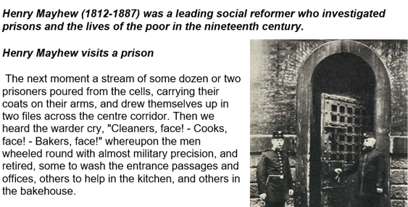
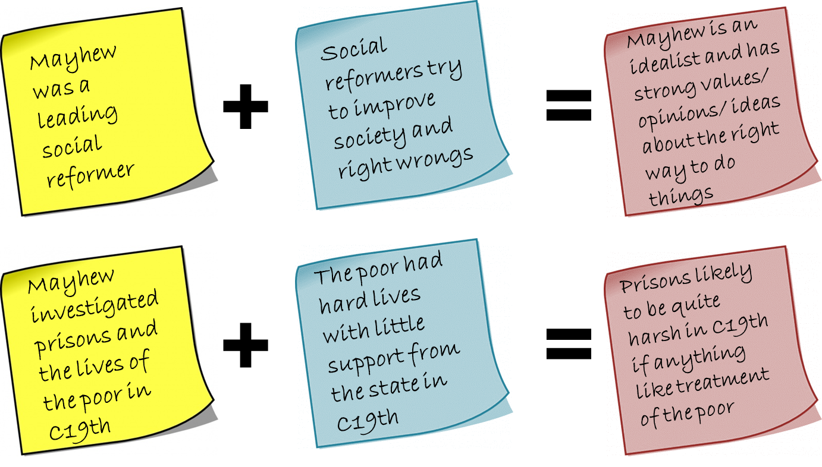
Inference sums: additional scaffolds to support students in making inferences
Information stated explicitly in the text
Background knowledge
Inferences

Slide 8
HIAS English Team
Please contact Joanna Kenyon Joanna.Kenyon@hants.gov.uk for support with secondary reading, whole school literacy and English.
For further details on the full range of services available please contact us using the following email: htlcdev@hants.gov.uk
Upcoming Courses
Keep up-to-date with our learning opportunities for each subject through our Upcoming Course pages linked below. To browse the full catalogue of learning offers, visit our new Learning Zone. Full details of how to access the site to make a booking are provided here.
English
Maths
Science
Geography
RE
History
Leadership
Computing
Art
D&T
Assessment
Support Staff
SEN
TED
MFL

Slide 9
Terms and conditions
Terms of use
This file is for personal or classroom use only. By using it, you agree that you will not copy or reproduce this file except for your own personal, non-commercial use. HIAS have the right to modify the terms of this agreement at any time; the modification will be effective immediately and shall replace all prior agreements.
You are welcome to:
download this resource
save this resource on your computer
print as many copies as you would like to use in your school
amend this electronic resource so long as you acknowledge its source and do not share as your own work.
You may not:
claim this resource as your own
sell or in any way profit from this resource
store or distribute this resource on any other website or another location where others are able to electronically retrieve it
email this resource to anyone outside your school or transmit it in any other fashion.

