Slide 1
Introducing students to features of text types within your subject area
­
Supporting all readers in the secondary school
Joanna Kenyon
May 2025
Final version

Slide 2
Overview
This document contains…
Slides that could be used as part of a CPD sequence for teachers in school, supporting understanding of reading in secondary schools
Points to consider when using this resource
The resources in this series are intended as a companion piece to the DfE’s series of training videos and guidance Supporting all readers in secondary school, providing additional detail. This resource expands on ideas shared in video 5, Identifying text features and provides links to research.

Slide 3
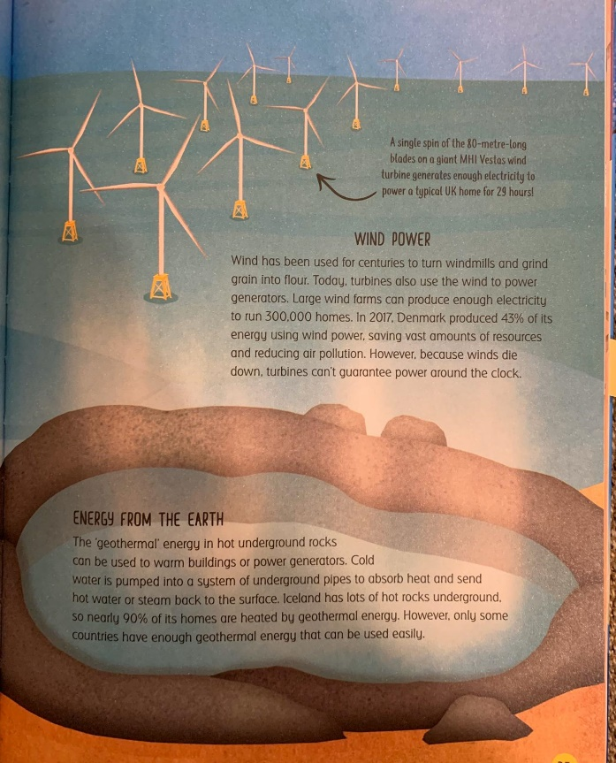
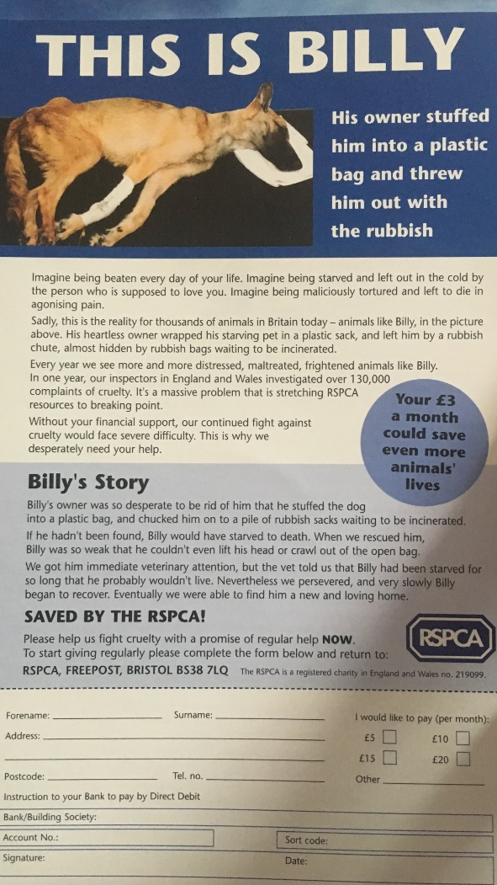
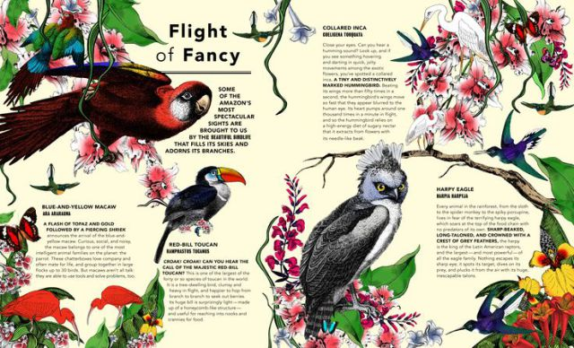
Connect to experience of similar texts
Presentational features
Use of images, graphic organisers, colours and font choices
Visual sequencing – what do you look at first and last?
Organisational principles
Headings and subheadings
Bold and italics for key terms
Relationship between text and images
Expectations – the contract between the reader and the writer
The writer provides enough information for the reader to make sense of the information; the reader perseveres to find the information
Notes:
Vo

Slide 4
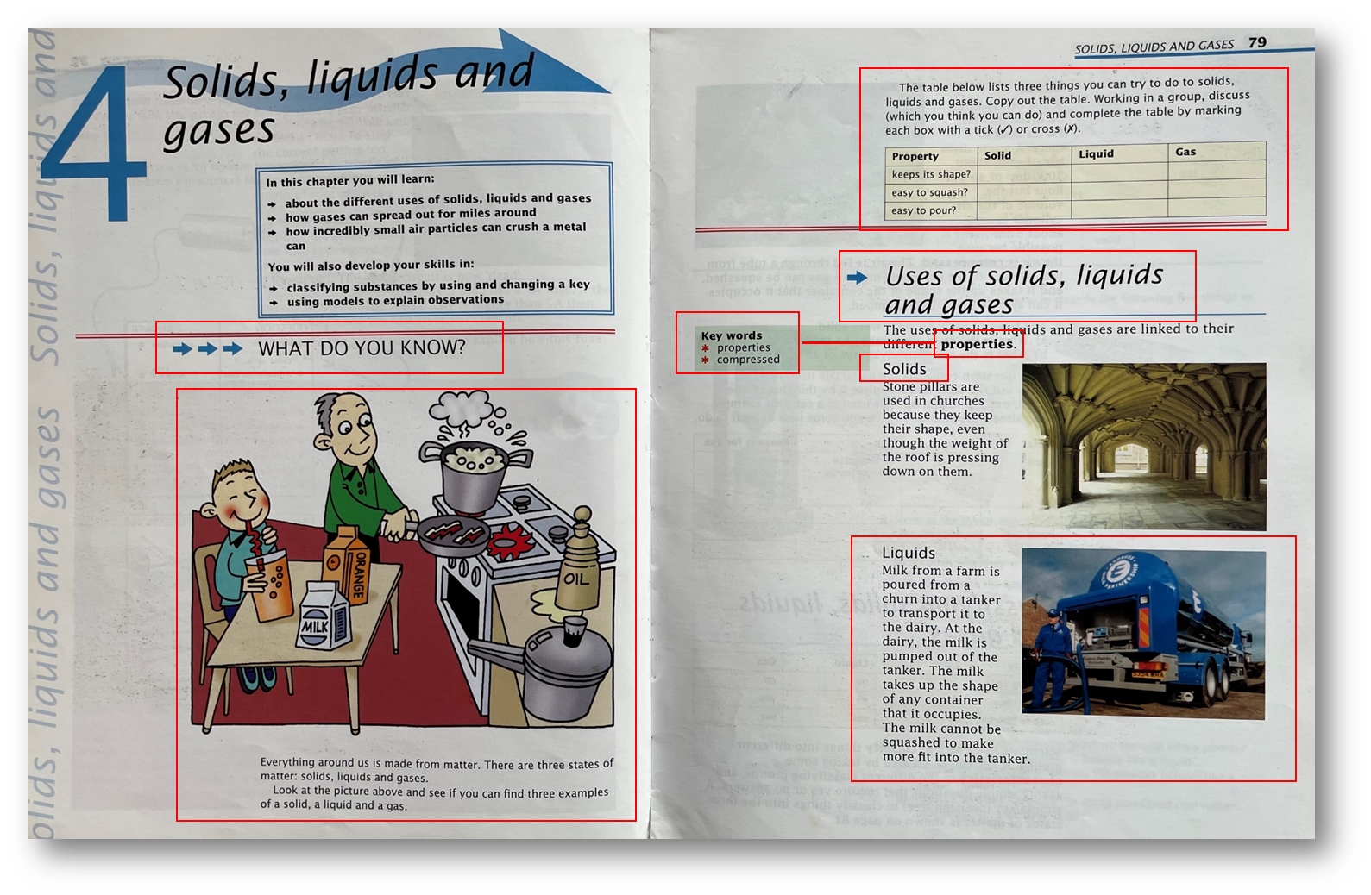
Are students familiar with the conventions of your subject’s textbooks?
Don’t assume that all students have used textbooks in the form or for the purposes that you might use them in Year 7
Spend some time talking them through features that might seem obvious, such as:
On this page, you can see the heading ‘Uses of solids, liquids and gases’ followed by subheadings for ‘solids’ and ‘liquids’, meaning that ‘gases’ is on the next page (primary pupils are very used to double-page spreads)
Features such as chapter previews, chapter summaries, fact boxes, use of bold and italics to highlight key words, illustrative images etc are useful in supporting understanding of the material in the chapter. However, some students are likely to think that they can use just these features to avoid reading the rest of the content. Model reading the whole text!

Slide 5
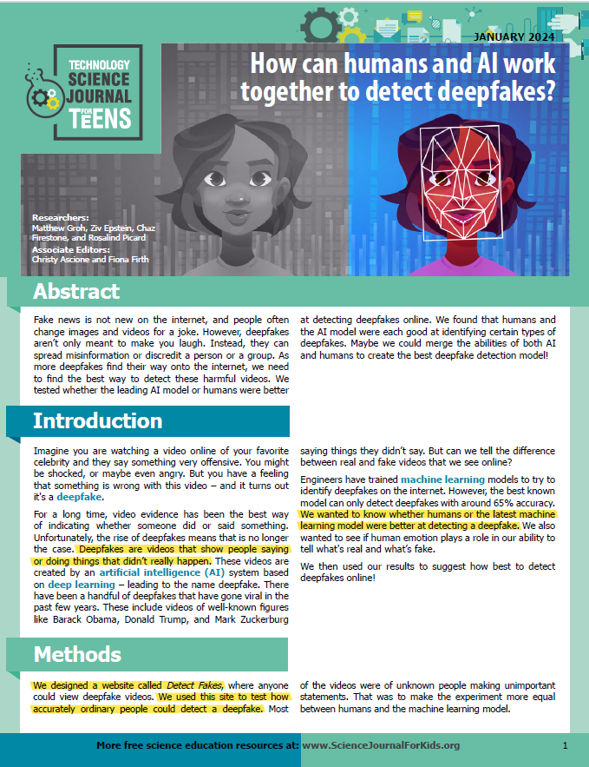
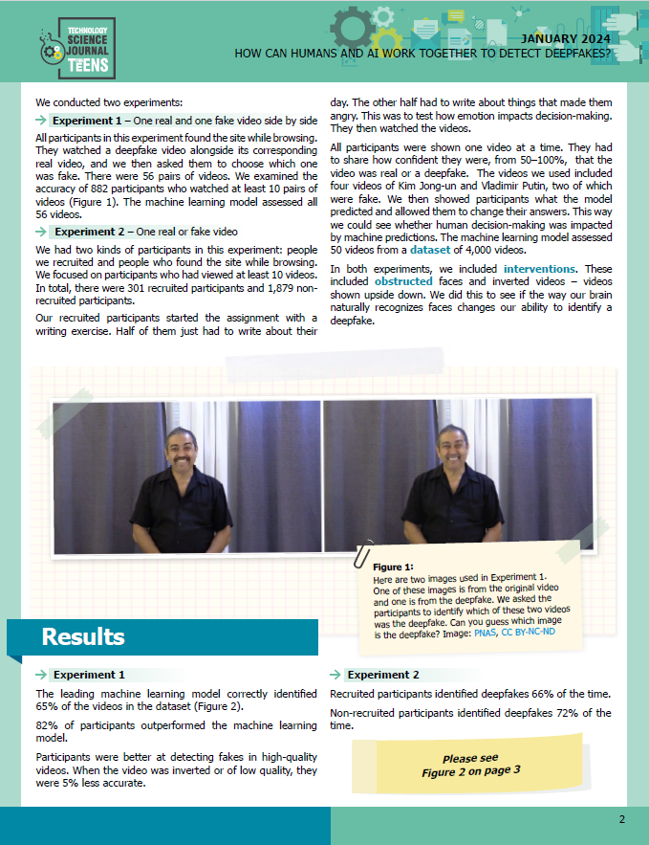
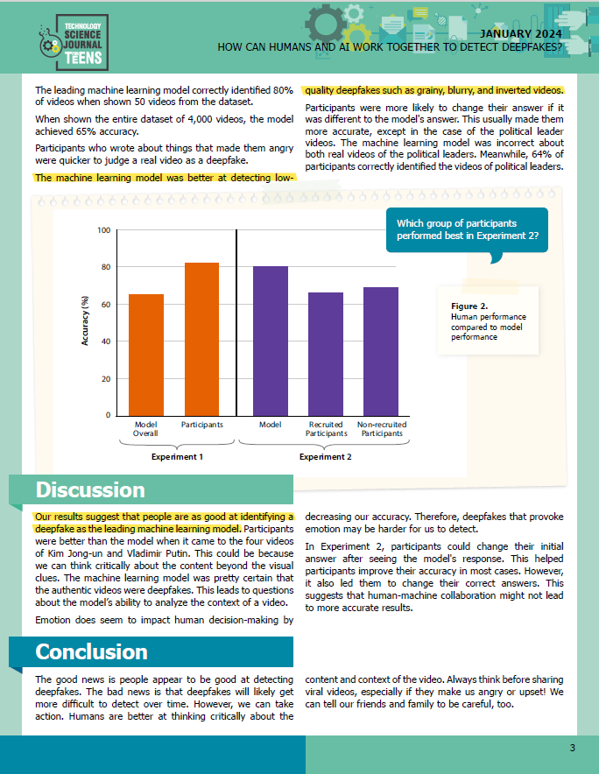
This scientific article aimed at teenagers can be used to familiarise students with the structure of a science paper, including the abstract, methods, results, discussion and conclusion. This is a more important text type for students to read in science than (for example) biographies of famous scientists.

Slide 6
Text-type features to explore
How to interpret data from tables, graphs and grids, and how to connect this data to the written content
How to follow step-by-step information, particularly when this information is combined with description and commentary, as in some recipes or instructions
How to use indexes, glossaries, summary boxes, annotations of images, maps
How to distinguish facts and opinions, and how to connect these to the context within which they are written or expressed
How to connect information from different sections of the page/s

Slide 7
HIAS English Team
Please contact Joanna Kenyon Joanna.Kenyon@hants.gov.uk for support with secondary reading, whole school literacy and English.
For further details on the full range of services available please contact us using the following email: htlcdev@hants.gov.uk
Upcoming Courses
Keep up-to-date with our learning opportunities for each subject through our Upcoming Course pages linked below. To browse the full catalogue of learning offers, visit our new Learning Zone. Full details of how to access the site to make a booking are provided here.
English
Maths
Science
Geography
RE
History
Leadership
Computing
Art
D&T
Assessment
Support Staff
SEN
TED
MFL

Slide 8
Terms and conditions
Terms of Use
This file is for personal or classroom use only. By using it, you agree that you will not copy or reproduce this file except for your own personal, non-commercial use. HIAS have the right to modify the terms of this agreement at any time; the modification will be effective immediately and shall replace all prior agreements.
You are welcome to:
download this resource
save this resource on your computer
print as many copies as you would like to use in your school
amend this electronic resource so long as you acknowledge its source and do not share as your own work.
You may not:
claim this resource as your own
sell or in any way profit from this resource
store or distribute this resource on any other website or another location where others are able to electronically retrieve it
email this resource to anyone outside your school or transmit it in any other fashion.

