Slide 1
A Sound of Thunder by Ray Bradbury
HIAS HOME LEARNING RESOURCE
English home study unit
HIAS English Team
Spring 2020
Final version
© Hampshire County Council

Slide 2
Using the home learning materials
HIAS HOME LEARNING RESOURCE
How to use the materials
This resource bank includes materials for several stages of learning – you can use these as individual lessons or work through them as a journey.
You should complete all of the stages in order and aim to apply the learning from each stage to the final piece of writing.
It is up to you how you use your time. It is likely that you will take between 3 and 6 hours to complete all the stages, but neither of the writing challenges are intended to be timed pieces, so take as long as you like!
You may find it useful to discuss some of the stages with other students. However, if you prefer to work completely independently, that’s fine.
Where some stages suggest that you think about or make notes on a resource, you can use any format you like. If you would like more guidance on how to do this, examples and printable resources are attached at the end of this pack.
Your teacher may ask you to send in your work at the end of each stage, or they may ask you to manage your own study and send in the finished piece of writing. Check that you know what your teacher expects you to do before you start.

Slide 3
Learning stages
HIAS HOME LEARNING RESOURCE
This home learning journey leads towards a piece of narrative/descriptive writing about time travel and a persuasive article on the same theme. The main written outcome is a third person narrative that tells the story of travel to a distant time. The magazine article will persuade the government in the world of Ray Bradbury’s short story to either cease or continue the use of time travel for leisure purposes
Exploring the text
Responding to the text
Building knowledge of themes
Building vocabulary
Noticing the way the writing is structured
Mapping the text
Writing challenge #1
Writing challenge #2
Review, edit, publish

Slide 4
A Sound of Thunder
HIAS HOME LEARNING RESOURCE
Ray Bradbury’s short science fiction story A Sound of Thunder is widely available online. The story was published in 1952 and is set in 2055.
Read the story up to the following sentence: They moved silently across the room, taking their guns with them, toward the Machine, toward the silver metal and the roaring light.
Think about the following questions:
How is Eckels feeling about his hunting trip? What clues does the author give us about his state of mind?
How is the process of time travel described in the company advert? In the description can you find examples that link to the theme of life and death?
The man behind the desk states that the company “will give you the severest thrill a real hunter ever asked for.” What is the connotation of the word real in this sentence?
Tip: discussion can be useful for this task

Slide 5
Responding to the text
HIAS HOME LEARNING RESOURCE
Enjoy reading the remainder of the story.
Think about the following questions:
Do you like the story? Why?
Does the writer have a message for his readers? What might this be?
How do you feel about the main character, Eckels? Do you have any sympathy for him? Why/why not?
Have you read any science fiction before? Which elements make this story fit into the science fiction genre?
Imagine that the story is being adapted into a film. If you were the director, who would you cast in each role and why?

Slide 6
Building your knowledge of themes
HIAS HOME LEARNING RESOURCE
Although this is a short story, it deals with some important themes. Think about what the themes might be in the story and how these are expressed.
For example, the theme of power and the abuse of power is expressed through the references to the presidential election. President Keith, who seems relaxed and democratic, is elected before time is ‘changed’. Later, when the timeline is altered, Deutscher, who is described as “militarist” and “anti-human”, is elected. Bradbury might also be showing us that unless we stop them, powerful and dangerous people will inevitably take control.
In the resources section you will find a cut and match task which will enable you to make links between the text and the themes that it expresses.
Resources to help you organise your notes available at the end of this pack

Slide 7
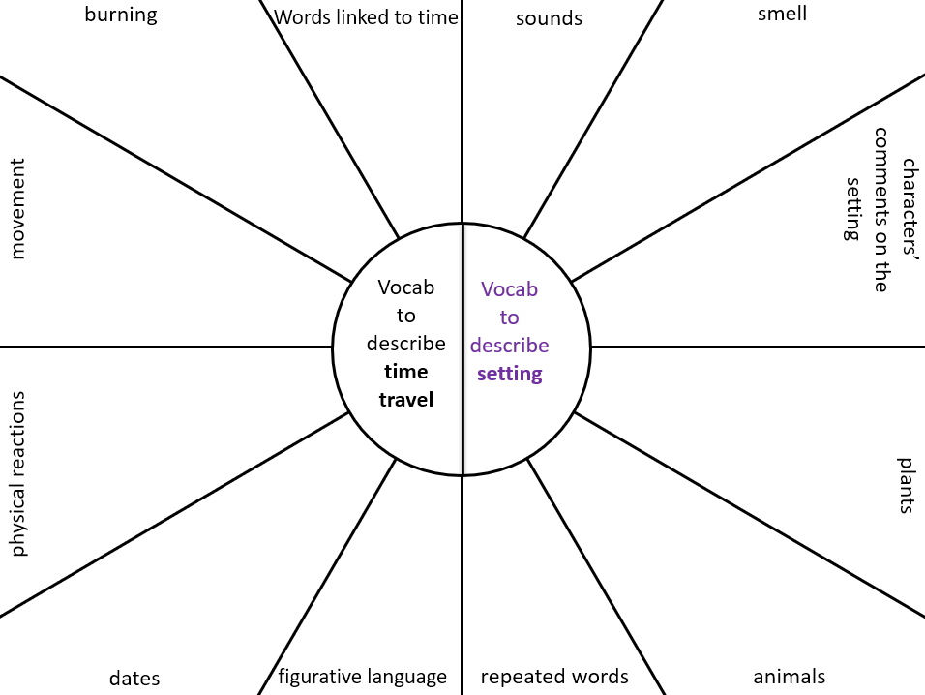
Building your vocabulary
HIAS HOME LEARNING RESOURCE
Build and organise your vocabulary to describe time travel and arrival in an unfamiliar setting. You can draw upon the vocabulary in the text to support your own time travel narrative.
The two key areas to focus on are the description of time travel itself in the story and the description of the unfamiliar setting once the travellers arrive.
Complete the vocabulary bank to support you to consider the vocabulary used in these areas. You may not need to complete every section.

Slide 8
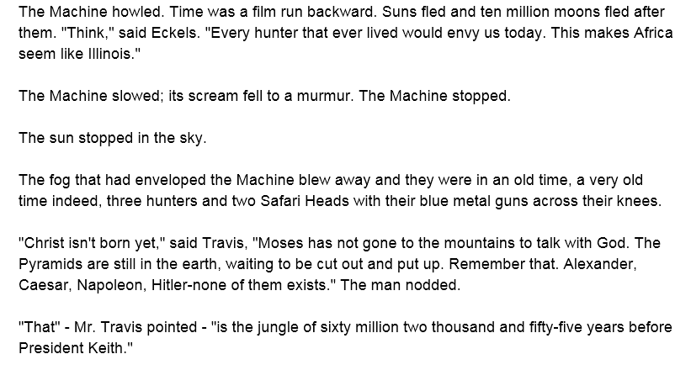
Noticing the writer at work
HIAS HOME LEARNING RESOURCE
In our time travel narrative we will have to think about the first moments when our characters emerge from the time machine.
Think about the questions to support your understanding of the author’s style in this section.
Questions:
Why do you think the author chose the words ‘howled’, ‘scream’ and ‘murmur’ to describe the sound of the machine? What is the effect?
How does the characters’ speech reinforce the enormity of the time travelled?
Why does the author choose to start most sentences with a noun phrase rather than trying to vary his sentence starters?

Slide 9
Mapping the text
HIAS HOME LEARNING RESOURCE
What happens in the paragraph/section? | Intended effect on the reader | Vocabulary/ useful quotes
The time machine starts and accelerates, moving through years and decades at speed. | To demonstrate how quickly time can be navigated in the machine. | A.D. 2055. A.D. 2019. 1999!1957! Gone! The Machine roared.
The men in the machine are described. Eckels’ physical reaction to time travel is also described. | To demonstrate the unsettling and frightening nature of the journey. | Eckels swayed on the padded seat, his face pale, his jaw stiff.
Complete the table recognising the structure of Ray Bradbury’s story, from the time machine starting to the hunters beginning to explore the landscape. (Read from ‘First a day and then a night and then a day and then a night…’ up to the following section “That" – Mr. Travis pointed…)
This will support you when you come to write your own narrative.
Use the table in the resources section for this task.
Resources to help you organise your notes available at the end of this pack

Slide 10
Writing challenge #1
HIAS HOME LEARNING RESOURCE
Write a time travel narrative featuring a journey in a time machine and an exploration of a new setting.
Use the grid in the resources section to plan your writing.
You will need to decide on your main character and the point in time to which they are travelling. Also consider the possible motives for your character’s journey.
Look back at your vocabulary work to support your planning. Aim to include precise vocabulary choices.
Try to imitate the features that Bradbury uses in your own writing:
Describe the physical impact of time travel on your character.
Use personification to describe the time machine.
Use speech to emphasise the distance travelled and the unreal nature of arrival in the setting.
This piece of writing should be at least 4-5 paragraphs long – approximately 1-2 sides of handwriting or ¾ – 1 side typed.

Slide 11
Responding to the text
HIAS HOME LEARNING RESOURCE
Summarise the ways in which the company, Time Safari Inc., tries to avoid changing history:
What equipment have they developed?
What rules have they put in place?
What do they do in order to minimise the risk of changing history?
What reasons do they give for each of their strategies?
Further exploration
One of the key ideas explored in A Sound of Thunder is known as chaos theory or ‘the butterfly effect’. If you are interested to find out more about these ideas, follow these links:
Simple explanation of chaos theory from Jurassic Park
Simple English Wikipedia
TEDX Talk from Samuel Won explaining chaos theory
Tip: discussion can be useful for this task

Slide 12
Writing challenge #2
HIAS HOME LEARNING RESOURCE
Write a magazine article setting out the case for preventing the use of time travel for leisure purposes. Alternatively, you could choose to argue in favour of continuing the practice and set out the benefits of time travel.
Use the grid in the resources section to plan your writing. The following is a partially completed grid to support your thinking:
This piece of writing should be at least 4-5 paragraphs long – approximately 1-2 sides of handwriting or ¾ – 1 side typed.
Introduction – outlining your argument | Time travel should be prevented – It could have disastrous consequences for us It is dangerous for participants It is an inappropriate use of technology
Point 1 | Time travel could have disastrous consequences for our civilisation. Even a small change could disrupt the future and our present. Examples: the accidental removal of a species, the introduction of diseases/bacteria to earlier times, the possibility of leaving technology/items in the past

Slide 13
Edit and improve
HIAS MOODLE+ RESOURCE
What do you need to ADD to your writing?
Does your writing need more detail for the reader – maybe to build a more vivid description, or add detail to help the reader understand the event / issue / character viewpoint?
What do you need to REPLACE or REVISE in your writing?
This might be individual words / phrases or a whole paragraph. Could you revise some of your choices to more appropriate words or more / less intense word choices? Think in particular about the intensity of the verbs you use.
What words / phrases / paragraphs should you TAKE AWAY?
Perhaps they are overloaded with adjectives, perhaps there is unnecessary repetition. You need to think about quality rather than quantity. Sometimes less writing is more powerful. Consider how to make the moments of clarity stand out.
Which words / phrases / paragraphs need to MOVE AROUND ?
You need to make sure your writing makes sense and flows easily for the reader.
How will you ensure your writing has cohesion and a strong overall structure?

Slide 14
Polish and publish
HIAS HOME LEARNING RESOURCE
Hand in the final version(s) of your work to your teacher.
Extra credit: If you have typed your work, print your final version with wide margins and double-spaced lines. In the space around the text, annotate your writing to explain the choices you have made and the way that you have included the key features from this unit. Photograph this annotated version to hand in.

Slide 15
Resources
HIAS HOME LEARNING RESOURCE
A Sound of Thunder

Slide 16
Building your knowledge of themes
HIAS HOME LEARNING RESOURCE
Cut and match the quotes with the themes that they relate to. Some quotes may fit with more than one theme.
Themes | Quotes | Quotes
Hunting | Not that fool weakling Keith. We got an iron man now, a man with guts! | Not knowing it, we might kill an important animal, a small bird, a roach, a flower even, thus destroying an important link in a growing species
Power and the abuse of power | Step on a mouse and you leave your print, like a Grand Canyon, across Eternity. Queen Elizabeth might neverbe born, Washington might not cross the Delaware, there might never be a United States at all. | He glanced at the two hunters. "You want the trophy picture?"
Small actions can have big consequences | We're lucky. If Deutscher had gotten in, we'd have the worst kind of dictatorship. | We're here to give you the severest thrill a real hunter ever asked for. Traveling you back sixty million years to bag the biggest game in all of Time

Slide 17
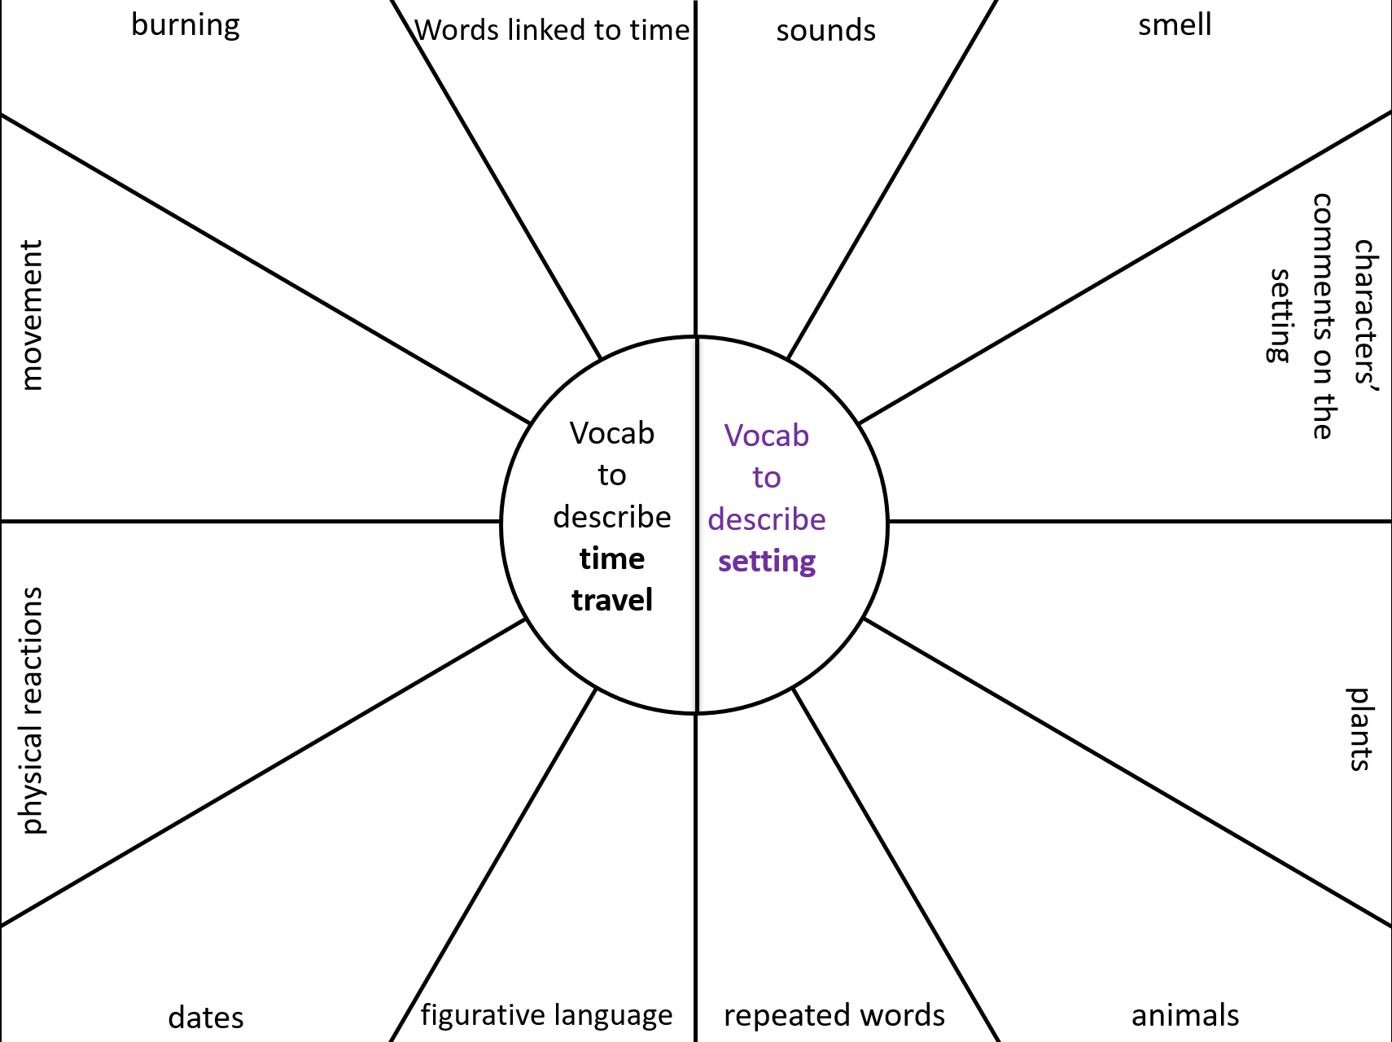

Slide 18
HIAS HOME LEARNING RESOURCE
What happens in the paragraph/section? | Intended effect on the reader | Vocabulary/ useful quotes
The time machine starts and accelerates, moving through years and decades at speed. | To demonstrate how quickly time can be navigated in the machine. | A.D. 2055. A.D. 2019. 1999! 1957! Gone! The Machine roared.
The men in the machine are described, as is Eckels’ physical reaction to time travel. | To demonstrate the unsettling and frightening nature of the journey. | Eckels swayed on the padded seat, his face pale, his jaw stiff.
Eckels asks how to kill the dinosaurs. Travis advises him.
 |  | The Machine slowed; its scream fell to a murmur. The Machine stopped.
Travis reminds the group how far they have travelled back in time.

Slide 19
Mapping out your own writing
HIAS HOME LEARNING RESOURCE
What happens in the paragraph? | Intended effect on the reader | Vocabulary

Slide 20
HIAS HOME LEARNING RESOURCE
Introduction – outlining your argument
Point 1
Point 2
Point 3
Conclusion – reinforcing your argument

Slide 21
HIAS English team
HIAS HOME LEARNING RESOURCE
The HIAS English team offer a wide range of high-quality services to support schools in improving outcomes for learners, including courses, bespoke consultancy and in-house training.
During the current school closures, we are still offering school support in a variety of ways such as video conferencing, phone calls and bespoke creation of resources remotely. Coming soon will be teacher training via virtual classrooms. We would be happy to discuss your needs.
For further details referring to English, please contact the English team leader:
Emma Tarrant : emma.tarrant@hants.gov.uk
For further details on the full range of services available please contact us using the following details:
Tel: 01962 874820 or email: hias.enquiries@hants.gov.uk
For further details on the full range of services available please contact us using the following details:
Tel: 01962 874820 or email: hias.enquiries@hants.gov.uk

