Slide 1
Rhythm and Poetry
HIAS HOME LEARNING RESOURCE
Year 7
HIAS English Team
Spring 2020
Final version
© Hampshire County Council

Slide 2
Using the home learning materials
HIAS HOME LEARNING RESOURCE
How to use the materials
This resource bank includes materials for several stages of learning – you can use these as individual lessons or work through them as a journey.
You should complete all of the stages in order and aim to apply the learning from each stage to the final piece of writing.
It is up to you how you use your time. This unit should take roughly 2 and a half hours, but you might want to spend longer on the final writing outcome to make sure that it is the best you can do. You might decide to spend half an hour a day on each learning stage, or you might decide to work through more than one stage in a block.
You may find it useful to discuss some of the stages with other students. However, if you prefer to work completely independently, that’s fine.
Where some stages suggest that you think about or make notes on a resource, you can use any format you like. If you would like more guidance on how to do this, examples and printable resources are attached at the end of this pack.
Your teacher may ask you to send in your work at the end of each stage, or they may ask you to manage your own study and send in the finished piece of writing. Check that you know what your teacher expects you to do before you start.

Slide 3
Learning stages
HIAS HOME LEARNING RESOURCE
This home learning journey leads towards a choice of writing outcomes – you could write a poem or a story inspired by the poetry and the ideas of the poet.
Poet study – explore the poet’s life story, ideas and feelings
Explore ‘lyrical pictures’ – the poet’s use of extended metaphor
Explore the use of rhythm and rhyme in hip-hop poetry
Explore how the poet expresses his ideas in The Misinformation Age
Writing Challenges

Slide 4
HIAS HOME LEARNING RESOURCE
‘Never thought I would be doing this’
‘new worlds’
‘artist’
‘SLAM’
‘power’
Explore the words and phrases here and look for patterns – how would you group them if you could move them around?
What do you think the text will be about?
How do you imagine the writer?
What makes you think these things?
‘MC’
‘art form’
‘photographs’
‘transported’
‘thankful’
‘lyrical pictures’
‘words’
‘culture’
‘taking time’
‘memories’
‘painting pictures’
‘my own story’
‘being heard’
‘thoughts in my head and feelings in my chest’
‘William Wordsworth’
‘stitching and weaving’
‘active imagination’
‘different universes’
‘prison yard’
Tip: discussion can be useful for this task

Slide 5
Exploring Karl Nova’s ideas and feelings – ‘role on the wall’
HIAS HOME LEARNING RESOURCE
You might already be familiar with the ‘role on the wall’ task, which is used to develop your inferences about a character or writer. It was first used by actors rehearsing a play who needed to work out what the characters they were playing were motivated by – some feelings and thoughts are more obvious than others.
Draw out the shape of a person on a large sheet of paper – you will need plenty of space both inside and outside the shape so that you can fill the paper with notes.
Outside the figure, note down all the facts you can find out about the poet from his poems – back these up with quotations from the poems.
Inside the figure, note down all the emotions and ideas that you think the poet has revealed in his poems. Be as sensitive as you can and look closely for the subtle clues in the poems about his feelings and attitudes.
Read 'I write these poems'
Read 'For You’
Read 'Poetry?’
Read 'The City of My Birth’

Slide 6
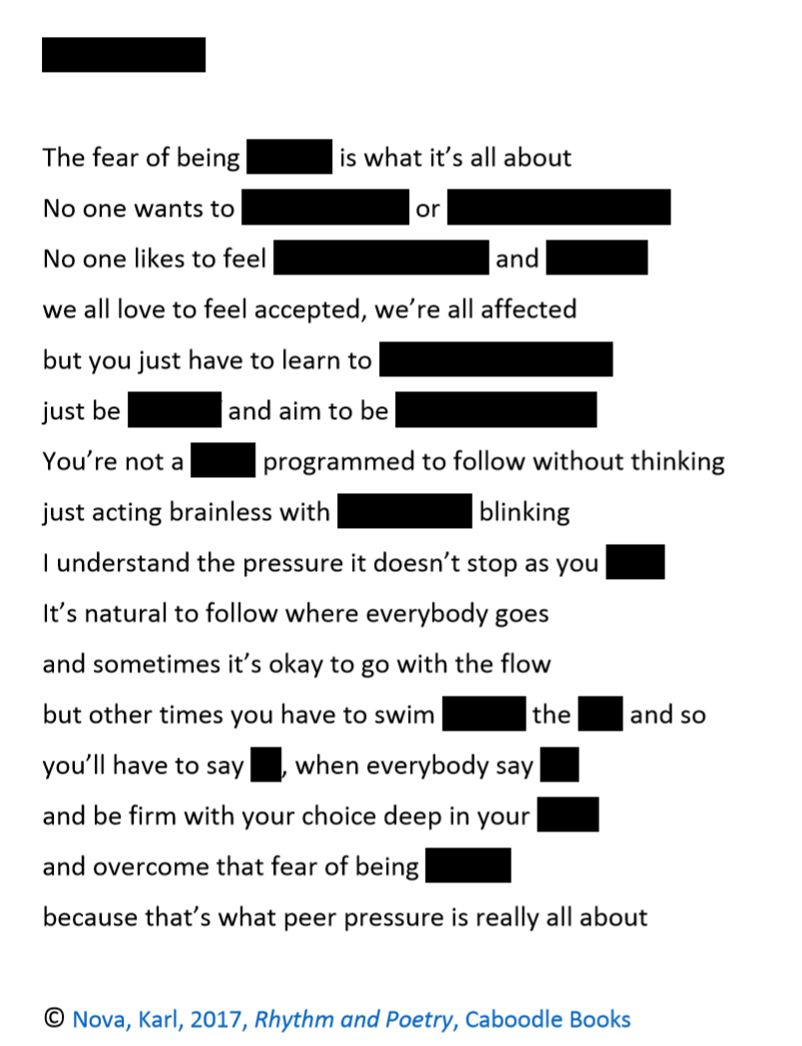
Fill in the blanks
HIAS HOME LEARNING RESOURCE
Using what you know about Karl Nova’s style, thoughts and ideas from reading a selection of his poems, which words do you think would complete the poem?
Write out a version with the gaps filled and explain your choices.
When you are finished, look here for the original version of the poem

Slide 7
Exploring ‘lyrical pictures’
HIAS HOME LEARNING RESOURCE
Look at the poem ‘Boys in the Woods’. In this poem, Nova has used an extended metaphor to get across his ideas.
What ideas about life and growing up (for young men) has Nova expressed through the image of the woods?
How has Nova used the image of a tree to explore ideas about how to be a better person and a better friend?
Draw the images suggested by the poem and annotate the picture you have drawn in detail with your ideas about the layers of meaning in each part of the image.

Slide 8
Explore rhythm and rhyme
HIAS HOME LEARNING RESOURCE
Look at the way that hip-hop artists have used rhyme and rhythm in their songwriting over the last 40 years and consider how these artists have influenced Karl Nova’s poetry
Explore the examples in the next few pages and notice:
Where the beats are in the bar/line
How rhymes are built inside the lines as well as at the ends of lines
How ‘daisy chain’ rhymes are used across a number of lines
How multi-syllable rhymes are used
How rhymes focus on the vowel sounds of words

Slide 9
The Breaks by Kurtis Blow (1980)
One of the first rap hits
Straightforward 4 beat lines (bars)
Simple end rhymes of one syllable
Rhyming couplets

Slide 10
Eric B is President by Eric B and Rakim (1987)
Hip-hop pioneers
Internal rhymes on the beat (4 beat lines/bars with shifting rhythm)
Multi-syllable rhymes at the ends of lines

Slide 11
Re:Definition by Mos Def (1997)
Multi-syllable rhymes and half-rhymes repeated within and across lines
4 beat lines/bars
Very fast to showcase verbal dexterity and mastery of hip-hop form

Slide 12
Lose Yourself by Eminem (2004)
‘Daisy chain’ rhymes – repeated and interleaved rhymes driving on the beats

Slide 13
My Shot from the musical Hamilton (2015)
Hip-hop style rhythm and rhyme:
Internal rhymes
Daisy-chain rhymes
Shifting beat

Slide 14
The Misinformation Age by Karl Nova
HIAS HOME LEARNING RESOURCE
We’re in a time when everyone thinks their opinion is truth They think every thought they spew is absolute everyone seems to be an expert and a critic that seeks to speak for everyone I don’t get it Conspiracy theories are making souls grow weary The fear of the unknown has got people feeling eerie We have a lot of information but very little truth A lot of speculation but hardly any proof Some think everything is true on YouTube That’s why perceptions are skewed on cue Some think everything has a message subliminal but if you say truth is in you, how can you continue to live in fear and remain paranoid Tossed to and fro by deceptions and decoys Lack of knowledge of the truth it destroys Sadly empty vessels still make the loudest noise We have a lot of information but little revelation that’s why there’s hardly transformation of situations What are you buying into? What holds your attention? ’cause what holds your attention holds you like detention
© Karl Nova 2019
Annotate the poem, picking out the way that the poet uses rhyme to draw your attention to particular words and phrases – if you have coloured pens, you could highlight words and phrases that rhyme in different colours to show the patterns.
Sum up the poet’s key messages in your own words.
Watch the poet reading the poem here

Slide 15
Writing Challenges
HIAS HOME LEARNING RESOURCE
Karl Nova said in an interview ‘I use poetry to say […] I am taking pictures from my phone and showing them to you. So let’s have a look at some lyrical pictures’. Choose random pictures from your phone and use one of them to give you the image for a poem that uses an extended metaphor to get across you ideas about one aspect of life.
Write a poem with a message inspired by ‘The Misinformation Age’ – tell your own truth about an issue that concerns you.
Write a story using Karl Nova as the main character – you can either write in the first person or the third person. Use what you know about Nova’s life, thoughts and feelings from his poems to write a story about him growing up and becoming a poet. Try to use images from the poems in your writing.
Write a diary entry as if you are Karl Nova’s English teacher at school – imagine what his teacher might have thought and felt about him when they discovered how much he loved to write poetry.

Slide 16
The Misinformation Age by Karl Nova
HIAS HOME LEARNING RESOURCE
We’re in a time when everyone thinks their opinion is truth They think every thought they spew is absolute everyone seems to be an expert and a critic that seeks to speak for everyone I don’t get it Conspiracy theories are making souls grow weary The fear of the unknown has got people feeling eerie We have a lot of information but very little truth A lot of speculation but hardly any proof Some think everything is true on YouTube That’s why perceptions are skewed on cue Some think everything has a message subliminal but if you say truth is in you, how can you continue to live in fear and remain paranoid Tossed to and fro by deceptions and decoys Lack of knowledge of the truth it destroys Sadly empty vessels still make the loudest noise We have a lot of information but little revelation that’s why there’s hardly transformation of situations What are you buying into? What holds your attention? ’cause what holds your attention holds you like detention
© Karl Nova 2019

Slide 17
HIAS English team
HIAS HOME LEARNING RESOURCE
The HIAS English team offer a wide range of high-quality services to support schools in improving outcomes for learners, including courses, bespoke consultancy and in-house training.
During the current school closures, we are still offering school support in a variety of ways such as video conferencing, phone calls and bespoke creation of resources remotely. Coming soon will be teacher training via virtual classrooms. We would be happy to discuss your needs.
For further details referring to English, please contact:
Emma Tarrant : emma.tarrant@hants.gov.uk
For further details on the full range of services available please contact us using the following details:
Tel: 01962 874820 or email: hias.enquiries@hants.gov.uk

