Slide 1
Danger! Building tension and writing action sequences
HIAS HOME LEARNING RESOURCE
Creative writing home study unit
HIAS English Team
Spring 2020
Final version
© Hampshire County Council

Slide 2
Using the home learning materials
HIAS HOME LEARNING RESOURCE
How to use the materials
This resource bank includes materials for several stages of learning – you can use these as individual lessons or work through them as a journey.
You should complete all of the stages in order and aim to apply the learning from each stage to the final piece of writing.
It is up to you how you use your time. It is likely that you will take between 3 and 6 hours to complete all the stages, but this is not a timed piece of writing and it is not to be treated as an exam piece. Take as long as you like!
You may find it useful to discuss some of the stages with other students. However, if you prefer to work completely independently, that’s fine.
Where some stages suggest that you think about or make notes on a resource, you can use any format you like. If you would like more guidance on how to do this, examples and printable resources are attached at the end of this pack.
Your teacher may ask you to send in your work at the end of each stage, or they may ask you to manage your own study and send in the finished piece of writing. Check that you know what your teacher expects you to do before you start.

Slide 3
Learning stages
HIAS HOME LEARNING RESOURCE
This home learning journey leads towards at least one, possibly two or more, piece(s) of narrative/descriptive writing about a life-or-death moment. The main written outcome is third person narrative that tells the story of a key moment from the film The Impossible. The writing will build up tension and then move into a dynamic action sequence.
Exploring the film – understanding the director’s craft
Content and vocabulary research
Exploring text extract 1: Jaws by Peter Benchley
Noticing the way the text is structured
Writing challenge #1
Exploring text extract 2: More Than This by Patrick Ness
Noticing the way the writer has crafted sentences
Writing challenge #2
Review, edit, publish
Creative application

Slide 4
The Impossible
HIAS HOME LEARNING RESOURCE
On 26 December 2004, a huge tsunami struck the Indian Ocean coastline in south-east Asia, devastating communities and killing more than 200,000 people. The Impossible, directed by J Bayona, is a film about how a single family were caught up in the events while on their Christmas holiday in Thailand.
The film is available to view in full on Netflix, YouTube and Google Play – if you want to watch the whole film, that’s up to you. However, the part we will focus on is this scene, which can be watched online for free:
The Impossible - the wave hits.
You will need to watch the scene several times in order to make detailed notes.
Think about the way the director has planned the scene in order to build up the tension in the moments before the wave hits.
What are the details you can see? Are all of them useful and important to the story?
What are your thoughts about the way the director uses colours and sounds?
How does the director gradually reveal the full power of the wave?
How does the order of the shots make the scene more tense?
Tip: discussion can be useful for this task

Slide 5
Building your knowledge
HIAS HOME LEARNING RESOURCE
Every published writer knows that it is important to research properly – otherwise they get a lot of letters pointing out their errors. When researching online, it is always useful to check at least three sources and bring the information together.
What is a tsunami? First-person account of being caught up in 2004 tsunami
How tsunamis form 2004 tsunami fact file from World Vision charity
TED-Ed Talk Real footage
Write a summary of how the 2004 tsunami was formed.
Identify the key vocabulary from the sources that will allow you to write about the tsunami with knowledge.
Resources to help you organise your notes available at the end of this pack

Slide 6
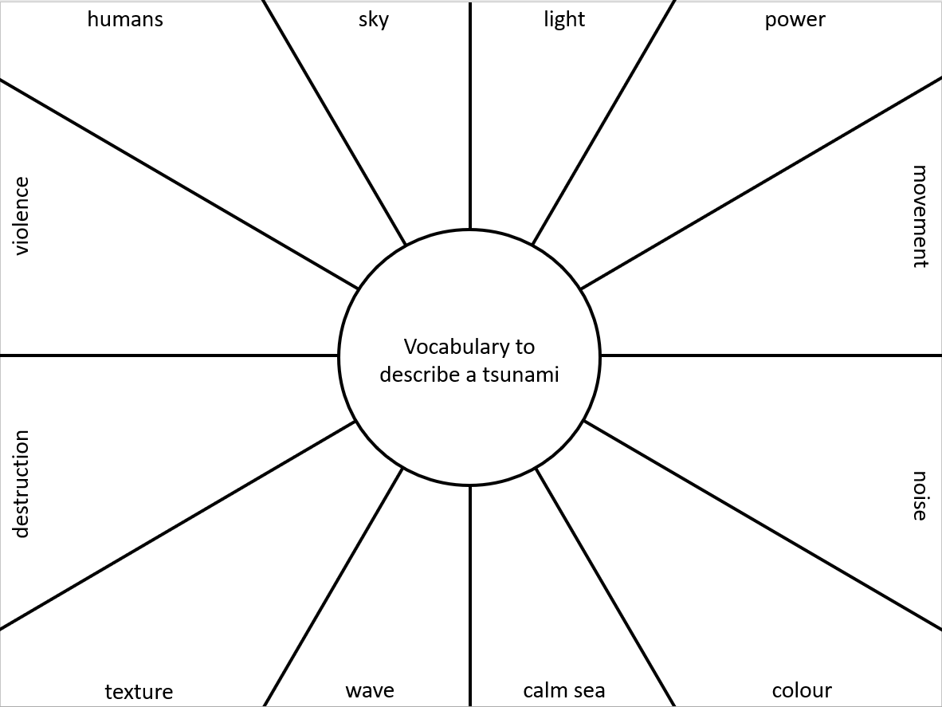
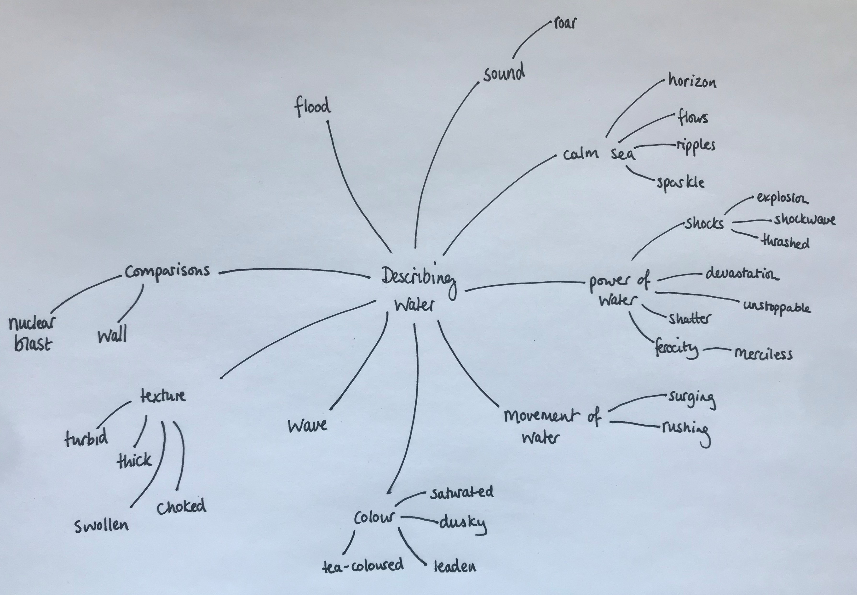
Building your vocabulary
HIAS HOME LEARNING RESOURCE
Build and organise your vocabulary to describe a tsunami.
Check out the excellent website Descriptionari.com, which includes a huge range of snippets of descriptive writing. Your task is to collect interesting vocabulary from the extracts and to organise them for yourself, thinking about what you will need to describe. When you have selected the vocabulary you like, you could also expand your vocabulary list by searching a thesaurus using the new words. Make sure that you know exactly what each world means and how it would be used in a sentence – if it is a new word to you, check in a dictionary.
You could decide to use one of these formats for your vocabulary bank:

Slide 7
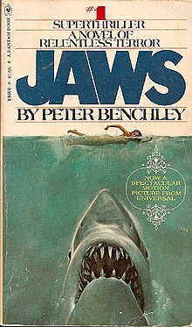
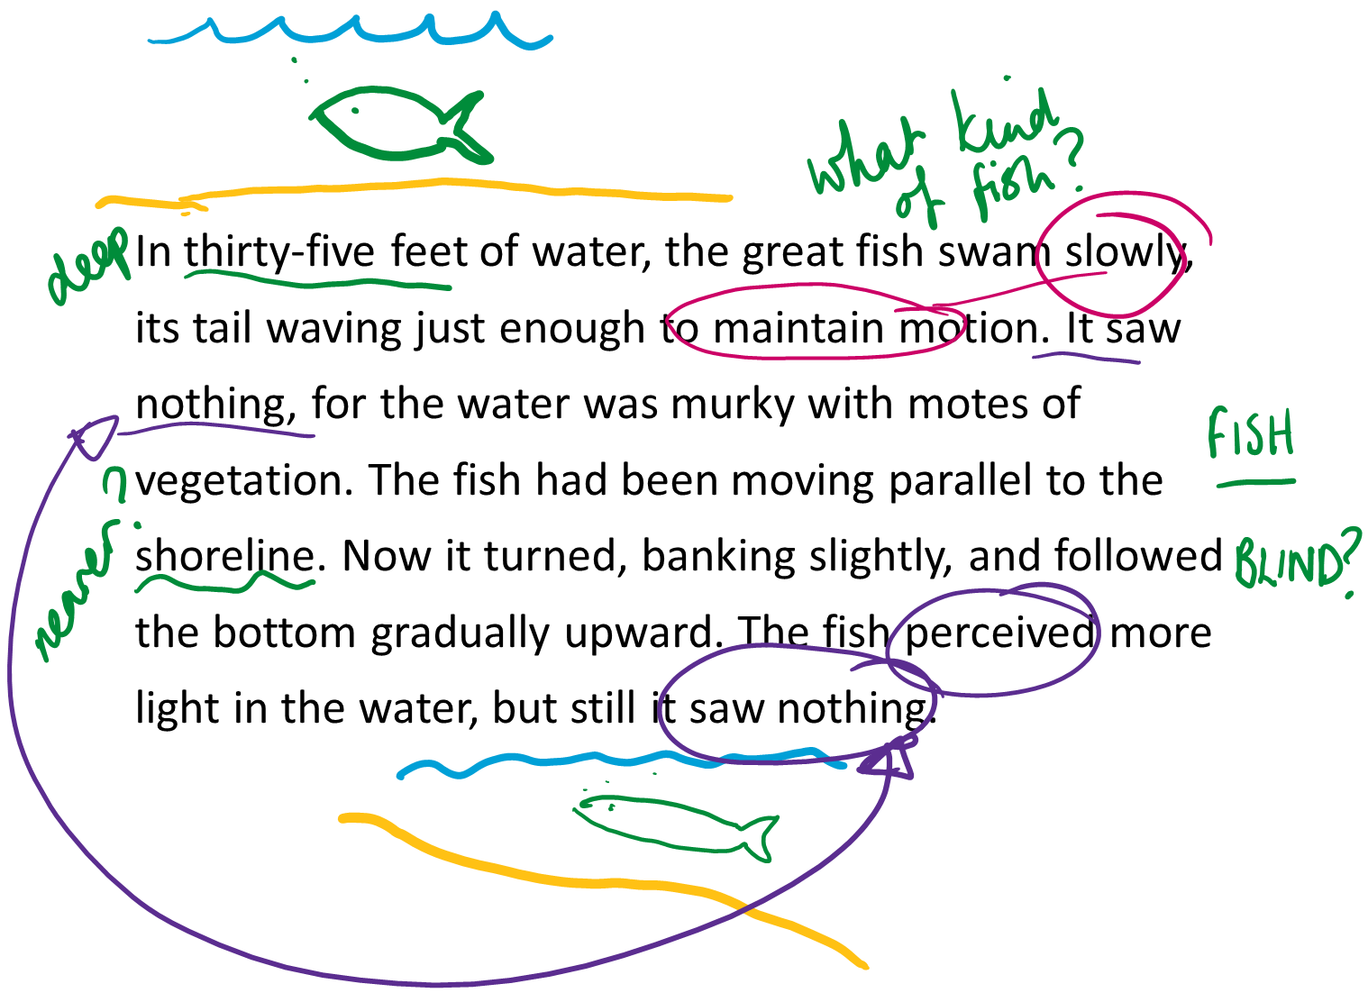
Jaws by Peter Benchley
HIAS HOME LEARNING RESOURCE
“In thirty-five feet of water, the great fish swam slowly, its tail waving just enough to maintain motion. It saw nothing, for the water was murky with motes of vegetation. The fish had been moving parallel to the shoreline. Now it turned, banking slightly, and followed the bottom gradually upward. The fish perceived more light in the water, but still it saw nothing.”
Read the whole passage here. It would be useful to print it out in order to annotate.
Make notes as you read to track your thoughts and reactions. Don’t try to analyse the text on the first read through – just read to understand and enjoy.

Slide 8
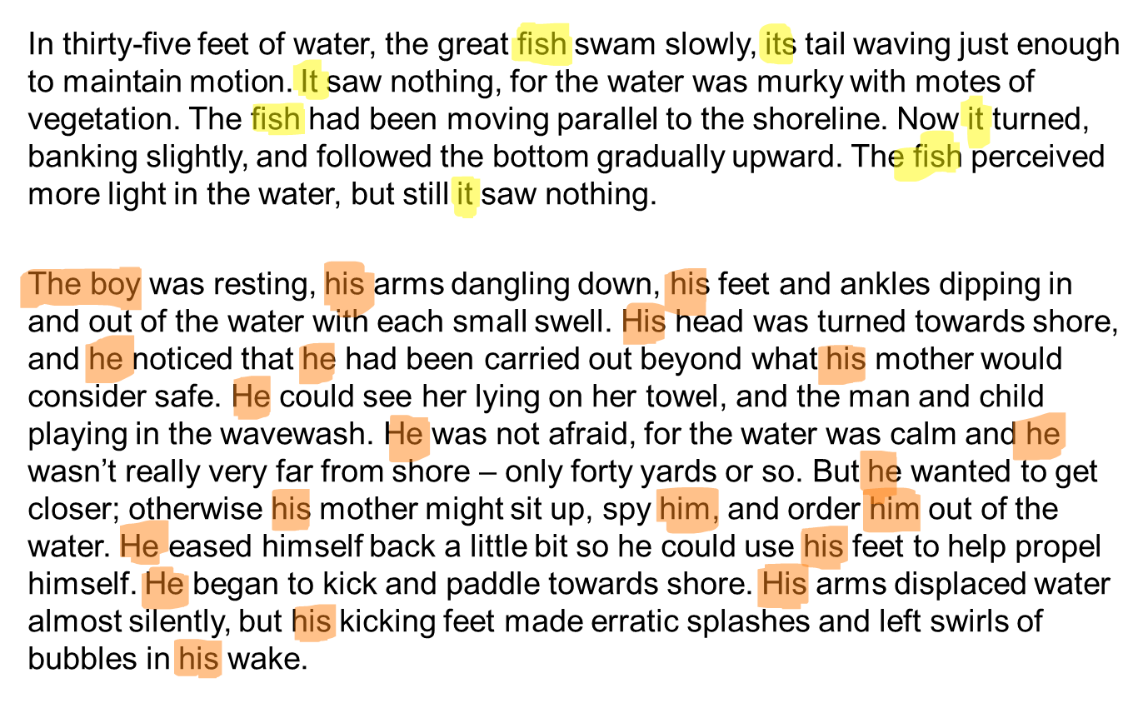
Noticing the way the text is structured #1
HIAS HOME LEARNING RESOURCE
Peter Benchley has structured the passage very carefully, keeping it tightly controlled in a noticeable way.
One way he keeps the text clear within a single paragraph is through the use of nouns (the fish/the boy) and pronouns (it/he) that clearly link to the same subject.
Questions:
What effect do you think the writer wanted to achieve by referring to the shark as ‘the fish’ and the character Alex Kintner as ‘the boy’?
Why does the writer choose to start most sentences with either a noun or a pronoun rather than trying to vary his sentence starters?
What differences do you notice between the first paragraph about the fish and the first paragraph about the boy?

Slide 9
Noticing the way the text is structured #2
HIAS HOME LEARNING RESOURCE
Benchley makes the deliberate stylistic choice to alternate between description of the fish and the boy.
Questions:
What do you notice about the way the focus changes as the passage goes on?
Where does the turning point come in the passage? What do you notice about this paragraph?
In Spielberg’s film version of this scene here, what techniques does the director use to imitate the structure of this piece of writing?

Slide 10
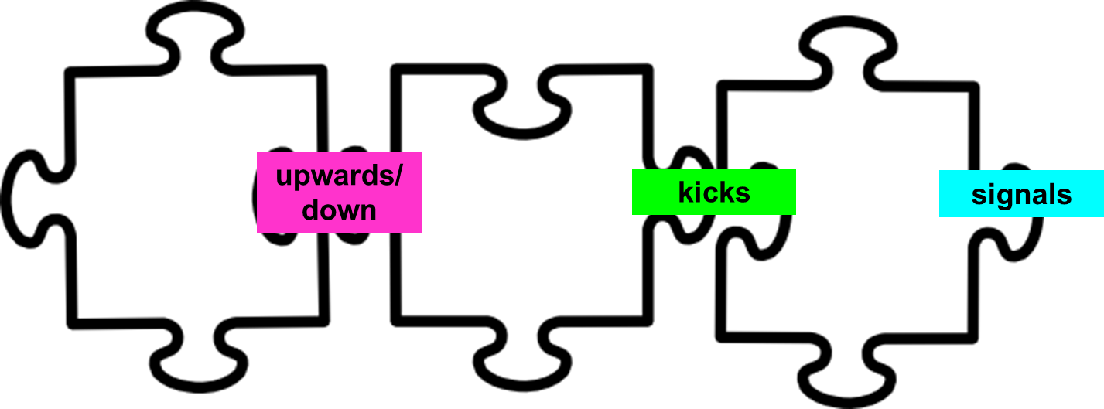
Noticing the way the text is structured #3
HIAS HOME LEARNING RESOURCE
Pay close attention to the way the writer has linked the paragraphs together. Benchley uses pairs of words between the final sentence of one paragraph and the first sentence of the next. These words are like the tabs of jigsaw pieces and hold the text together tightly.
Sometimes the words are pairs of opposites (upward/down)
Sometimes the pair of words are the same words in different forms (kicking/kicks)
Sometimes a word is simply repeated (signals)

Slide 11
Noticing the way the text is structured #4
HIAS HOME LEARNING RESOURCE
Without looking back at the text, put the verbs from the word cloud into the order that you think they occur in the text.
Group them into six paragraphs, then decide on the order in which they occur within the paragraph.
What do you notice about the effect of the verbs in order?
What do you think the writer intended?

Slide 12
Mapping the text
HIAS HOME LEARNING RESOURCE
What happens in the paragraph? | Intended effect on the reader | Jigsaw words
Description of shark at the bottom of the sea – not doing much. Describes what the shark sees/does. Starts swimming upward. | Distancing – positions reader as an observer. Details sound make it sound almost like a nature programme. Makes reader question what will come next. | Upward
Description of the boy on the lilo. Shifts to child’s perspective and looks at what he can see/what he thinks. Starts kicking feet. | Sympathy – engages with the boy’s perspective Anxiety – link with the shark | Dangling down Kick/ kicking
Complete the table recognising the structure of the extract from Jaws.
Planning your own writing
Now think back to the clip from The Impossible. In some ways, the two scenes are very similar: in both, an unseen danger draws nearer and nearer until disaster strikes.
Shark ⇨ wave
Boy ⇨ humans at the hotel
Use a similar grid to plan out a piece of writing based on the moment before the wave hits from The Impossible.
** Decide before you begin whether you are going to focus on a single human character (and if so, which one) or the humans as a group

Slide 13
Writing challenge #1
HIAS HOME LEARNING RESOURCE
Write the story up to the point where the wave hits
Try to imitate the structural features that Benchley uses in Jaws in your own writing:
Keep the first paragraphs very unemotional and observant in tone
Alternate between describing the danger and describing the human character
Use jigsaw words to link paragraphs together
Plan the verbs that you are going to use carefully so that they increase in intensity towards the moment when the wave hits.
This piece of writing should be at least 4-5 paragraphs long – approximately 1-2 sides of handwriting or ¾ – 1 side typed.

Slide 14
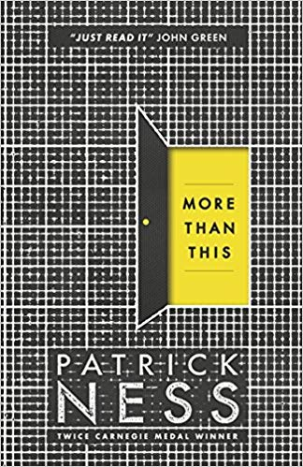
More Than This by Patrick Ness
HIAS HOME LEARNING RESOURCE
“Here is the boy, drowning.
In these last moments, it's not the water that's finally done for him; it's the cold. It has bled all the energy from his body and contracted his muscles into a painful uselessness, no matter how much he fights to keep himself above the surface. He is strong, and young, nearly seventeen, but the wintry waves keep coming, each one seemingly larger than the last. They spin him round, topple him over, force him deeper down and down.”
Read the whole first chapter here. It would be a good idea to print it out so that you can annotate it with your thoughts as you read. Don’t read to analyse – just read to understand and respond. On your second read-through, spend a few moments thinking about where you think you are in relation to the boy – how has the writer positioned you there? When do you feel closest to him?
Tip: If you want to consolidate your skills, look at this passage in the same way as you looked at the Jaws extract. You could complete all of the same activities again.

Slide 15
Noticing the way the writer has crafted sentences #1
HIAS HOME LEARNING RESOURCE
Patrick Ness has deliberately crafted sentence structures in a way that is closely linked to the meaning and the mood of the passage.
For example:
‘He is strong, and young, nearly seventeen, but the wintry waves keep coming, each one seemingly larger than the last.’
In this sentence the writer uses a list of three reasons why the boy ought to be able to survive – these three reasons are in short phrases and each one is separated by a comma.
In order to be correct grammatically, the first comma is not strictly necessary: the writer must have put it there for a reason.
Think about what is happening in the story at this point: the boy is struggling to stay alive in the water – the previous sentence says that he ‘fights to keep himself above the surface’.
It seems to me that the way the list is deliberately broken up with commas suggests the gasping of the boy as he gets his face above the surface of the water and then sinks back under again.
In the second half of the sentence, ‘but the wintry waves keep coming, each one seemingly larger than the last’, the clauses are longer – this makes me think that he is bobbing to the surface less often and that the gaps are longer as he loses strength.

Slide 16
Noticing the way the writer has crafted sentences #2
HIAS HOME LEARNING RESOURCE
Many of Ness’s sentences are long and complex, using a number of commas to manage the way the clauses pile up on one another. This seems to reflect the way the boy is being tossed and turned by the waves almost endlessly. However, at key points in the passage, Ness shifts into much shorter sentences, sometimes as stand-alone paragraphs.
For example:
‘It is too late for him.
He will die.
And he will die alone.’
Each of these short sentences is a clear, simple statement.
In contrast to the long, descriptive sentences that bring out the panicky feel of the situation, these are completely free of confusion – they seem like statements of fact and leave no room for doubt.
These sentences are the boy’s thoughts. By separating each one into a paragraph by itself, the writer allows the moments of realisation to sink in.
By using three of these stand-alone paragraphs in a row, Ness completely breaks the flow of the description and makes the horror of the situation clear and stark. It is a moment of stillness and clarity.
There is no need for the writer to add any extra description, detail or emotive language because what the boy is realising is bad enough on its own.

Slide 17
The imitation game
HIAS HOME LEARNING RESOURCE
One way to develop your own writing is to imitate what other writers do. Sentence imitation is a good way to practise writing in a more complex style than usual.
First, choose a sentence that you think is interesting – this does not have to be the most complex sentence in the text, just one that you thinks works well in the context.
Next, work out which words in the sentence are crucial to the meaning and which are the grammatical ‘framework’ of the sentence.
Keep the ‘framework’ and replace the content words.
For example:
‘In these last moments, it's not the water that's finally done for him; it's the cold.’
Now imagine that we wanted to shift the action completely to a different situation: let’s move the boy from the water to an Australian bush fire.
‘In these crucial minutes, it’s not the heat that’s finally driven him back; it’s the smoke.
We have kept the grammar of the sentence structure exactly the same, but we have changed the meaning completely.

Slide 18
Sentence imitation #2
HIAS HOME LEARNING RESOURCE
Here’s a slightly more complex example of sentence imitation from the Jaws extract you looked at earlier.
Original sentence:
‘In thirty-five feet of water, the great fish swam slowly, its tail waving just enough to maintain motion. It saw nothing, for the water was murky with motes of vegetation.’
Framework:
In… of …., the XXXXX ----ed ------ly, its … -----ing just enough to …
It ----ed …., for the xxxx was … with ….
Imitation:
‘In the furthest reaches of the solar system, the dwarf planet Pluto orbited silently, its perma-frosted surfaces glistening just enough to be seen through the telescope. It stopped for nothing, although the reaches of space were thick with drifting asteroids.’

Slide 19
Using sentence structure to reflect meaning
HIAS HOME LEARNING RESOURCE
Explore these sentences and consider how their structure reflects the meaning of the words.
They spin him round, topple him over, force him deeper down and down.
He forces his legs to kick, forces his arms to heave himself upward, to at least get his body the right way round, to try and grasp another breath just inches away –
He is unable to even try and swim now, unable to brace himself as the waves turn him over once more.
Then, without warning, the game the sea seems to have been playing, the cruel game of keeping him just alive enough to think he might make it, that game seems to be over.

Slide 20
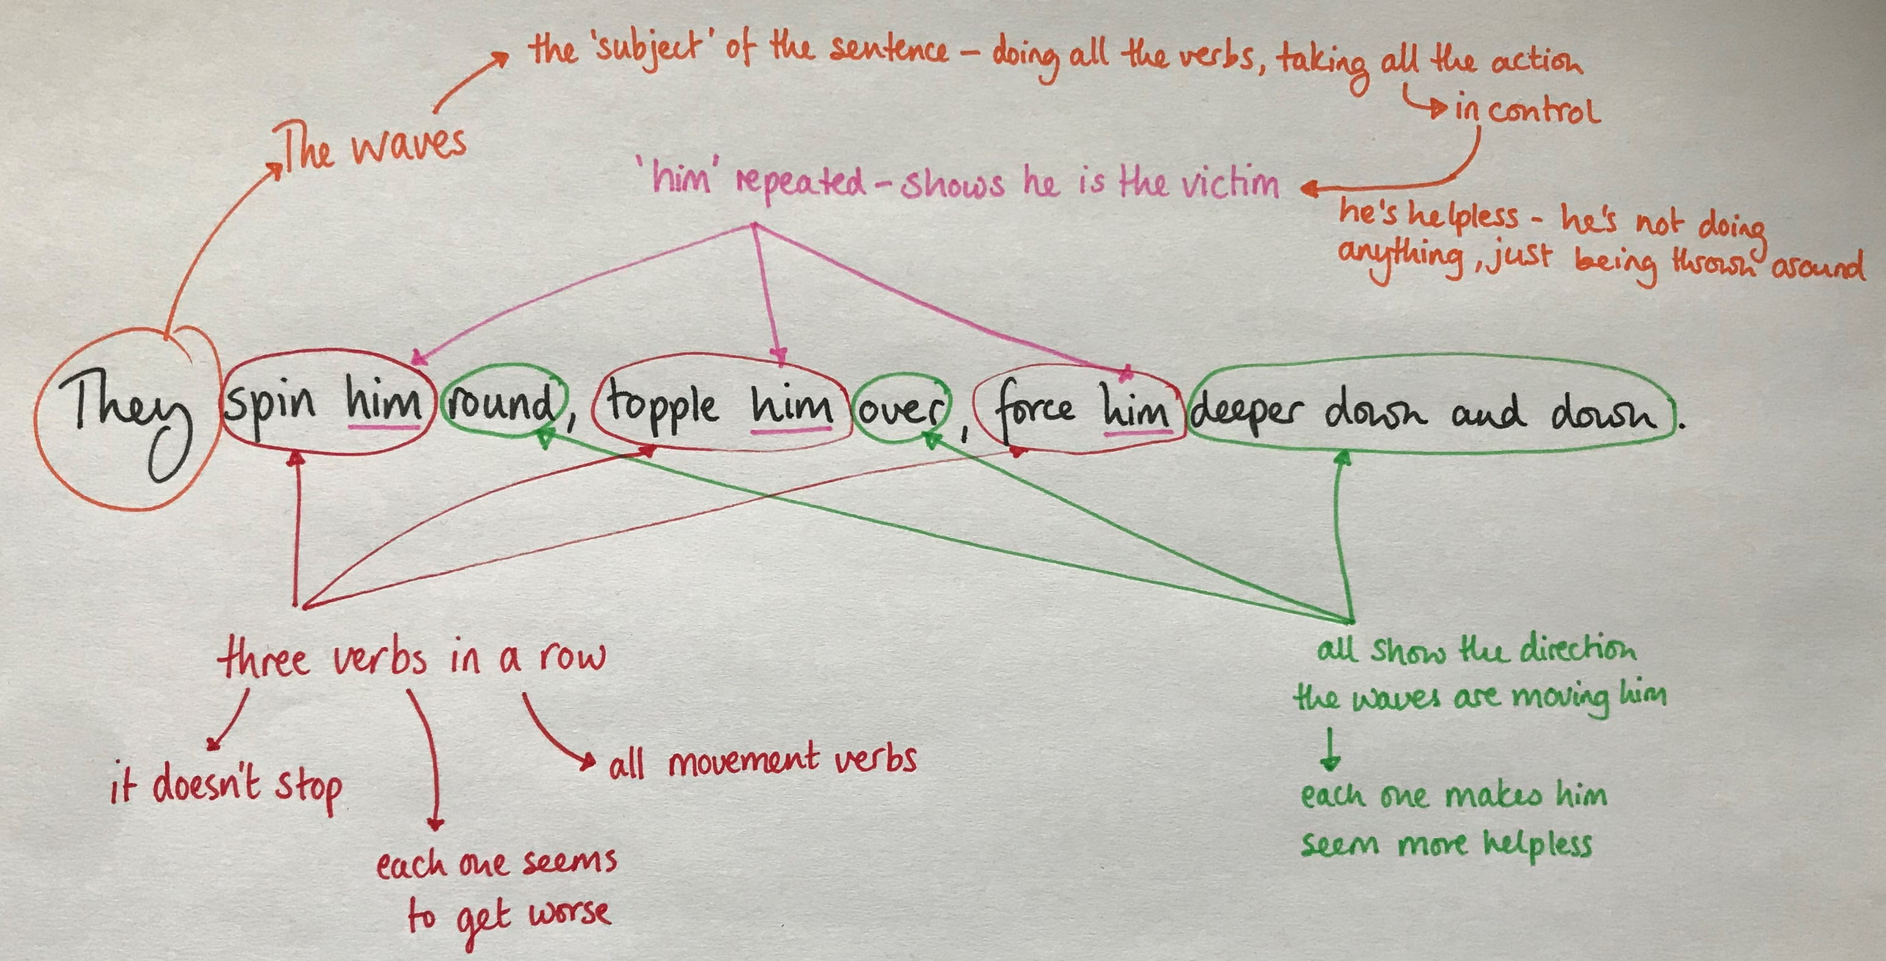
Explain
HIAS HOME LEARNING RESOURCE
For each sentence on the previous page, explain:
What is happening in the sentence
What feeling the writer is trying to create
How the structure of the sentence reflects that feeling
How the way the sentence is written links to the meaning of the words
You might decide to write out your explanations in the same way as the examples on previous pages, or you might decide to annotate each sentence, like this:

Slide 21
Change
HIAS HOME LEARNING RESOURCE
For each sentence:
Create a sentence framework for the sentence
Re-write the sentence for a different situation
**Remember that the feeling you create needs to be similar

Slide 22
Create: writing challenge #2
HIAS HOME LEARNING RESOURCE
Imitating the author’s style, write the next section of your story based on The Impossible,
Include in your writing some sentences that imitate Ness’s sentence structure as you try to recreate the feeling of breathless helplessness and fast movement as the characters are being swept along in the water.
Play from 1 minute 50 seconds

Slide 23
Review and evaluate
HIAS HOME LEARNING RESOURCE
Look back over your narrative inspired by The Impossible. You should, by now, have drafted a piece that tells the story shown in the film from the formation of the tsunami far out to sea, through the moment when the wave strikes and on to describe the experience of being swept along by the wave.
Have you:
Used alternating paragraphs focusing on the wave and the humans?
Used your research to ensure that you have written accurately about tsunamis?
Linked your paragraphs carefully and closely?
Thought carefully about your vocabulary choices?
Used a range of interesting sentence structures to reflect the meaning of the words?
Have you:
Built up tension?
Brought your story to a violent climactic moment?
Created a sense of desperation and helplessness?

Slide 24
Edit and improve
HIAS MOODLE+ RESOURCE
What do you need to ADD to your writing?
Does your writing need more detail for the reader – maybe to build a more vivid description, or add detail to help the reader understand the event / issue / character viewpoint?
What do you need to REPLACE or REVISE in your writing?
This might be individual words / phrases or a whole paragraph. Could you revise some of your choices to more appropriate words or more / less intense word choices? Think in particular about the intensity of the verbs you use.
What words / phrases / paragraphs should you TAKE AWAY?
Perhaps they are overloaded with adjectives, perhaps there is unnecessary repetition. You need to think about quality rather than quantity. Sometimes less writing is more powerful. Consider how to make the moments of clarity stand out.
Which words / phrases / paragraphs need to MOVE AROUND ?
You need to make sure your writing makes sense and flows easily for the reader.
How will you ensure your writing has cohesion and a strong overall structure?

Slide 25
Polish and publish
HIAS HOME LEARNING RESOURCE
Hand in the final version of your narrative to your teacher.
Extra credit: If you have typed your work, print your final version with wide margins and double-spaced lines. In the space around the text, annotate your writing to explain the choices you have made and the way that you have included the key features from this unit. Photograph this annotated version to hand in.

Slide 26
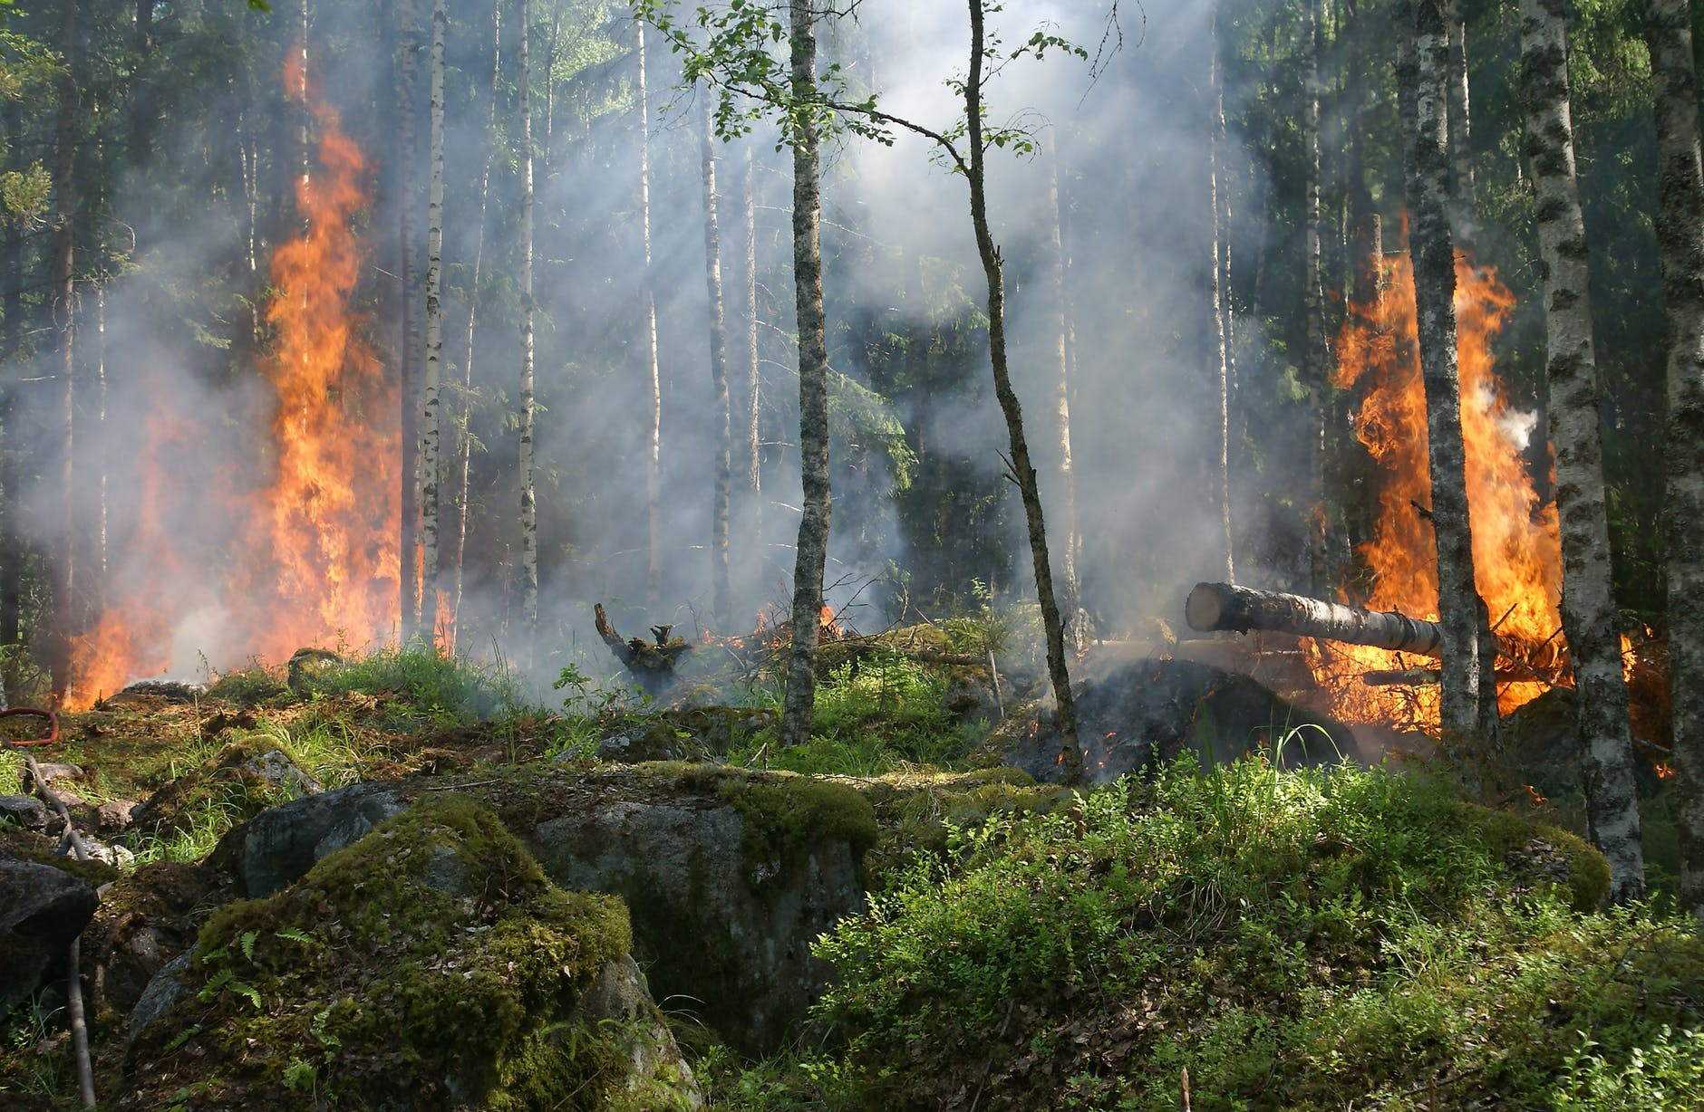
Creative application
HIAS HOME LEARNING RESOURCE
Once you have completed the final piece of writing from this home study unit, consider applying the learning to a completely fresh task. By working through the stages and imitating some of the features that the writers of the extracts have used, you should have built up your confidence and produced some excellent writing.
What other situations could you write about that would work well with the methods you have studied for creating tension and writing action sequences?

Slide 27
Printable resources
HIAS HOME LEARNING RESOURCE
Jaws extract
More Than This extract

Slide 28
Building knowledge of tsunamis
HIAS HOME LEARNING RESOURCE
What happens at each stage of a tsunami? | Key words

Slide 29
HIAS HOME LEARNING RESOURCE

Slide 30
Mapping out your writing
HIAS HOME LEARNING RESOURCE
What happens in the paragraph? | Intended effect on the reader | Jigsaw words

Slide 31
HIAS HOME LEARNING RESOURCE
They spin him round, topple him over, force him deeper down and down.
He forces his legs to kick, forces his arms to heave himself upward, to at least get his body the right way round, to try and grasp another breath just inches away –
He is unable to even try and swim now, unable to brace himself as the waves turn him over once more.
Then, without warning, the game the sea seems to have been playing, the cruel game of keeping him just alive enough to think he might make it, that game seems to be over.

Slide 32
HIAS English team
HIAS HOME LEARNING RESOURCE
The HIAS English team offer a wide range of high-quality services to support schools in improving outcomes for learners, including courses, bespoke consultancy and in-house training.
During the current school closures, we are still offering school support in a variety of ways such as video conferencing, phone calls and bespoke creation of resources remotely. Coming soon will be teacher training via virtual classrooms. We would be happy to discuss your needs.
For further details referring to English, please contact the English team leader:
Emma Tarrant : emma.tarrant@hants.gov.uk
For further details on the full range of services available please contact us using the following details:
Tel: 01962 874820 or email: hias.enquiries@hants.gov.uk
For further details on the full range of services available please contact us using the following details:
Tel: 01962 874820 or email: hias.enquiries@hants.gov.uk

