Slide 1
Guidance relating to the continued use of Letters and Sounds
Summer 2021
Emma Tarrant – Lead English Inspector / Adviser
emma.tarrant@hants.gov.uk

Slide 2
30th March 2021
The Department for Education made their position regarding the 2007 Letters and Sounds Handbook clear.
“The 2007 Letters and Sounds handbook, published under the previous Government, has never been a full Systematic Synthetic Phonics (SSP) programme. For a number of years, effective teaching using Letters and Sounds has relied on schools themselves building a programme around the handbook.”
Notes:
The DfE announced that it was not going to continue with its direct involvement in the restructuring of Letters and Sound and that the framework would be removed from the SSP list by March 2022.

Slide 3
30th March 2021
Having previously commissioned a group of outstanding schools, overseen by trusted phonics experts, to produce a more complete resource for Letters and Sounds, the DfE announced that it was not going to continue with its direct involvement in the restructuring of Letters and Sounds.
“This in no way reflects the quality of the work produced, but the Department’s current policy is that SSP programmes should be created by teachers and phonics experts. This means that the Department will not publish a full Letters and Sounds programme, nor an updated progression.”
Notes:
This included free videos and training materials for English Hub partner schools. Many schools will have accessed these resources during the pandemic to support remote learning.

Slide 4
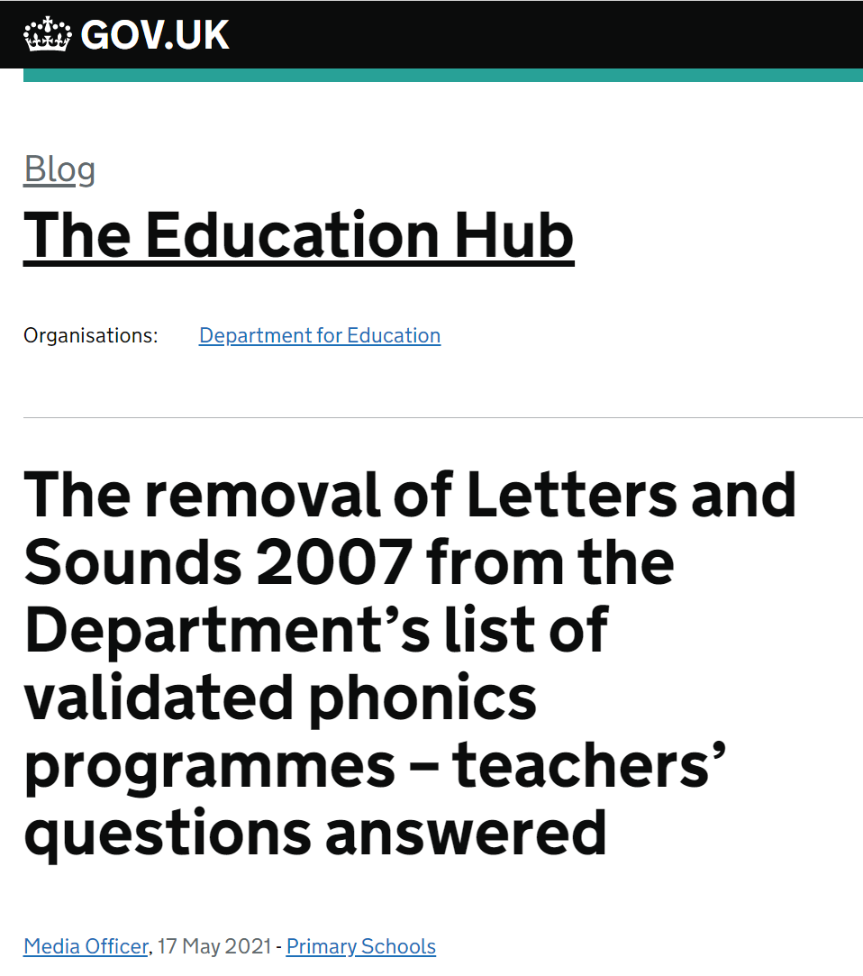
Questions were asked
As expected schools sought further clarity and the DfE responded with an Education Hub Blog to answer some of the FAQs.
https://educationhub.blog.gov.uk/2021/05/17/the-removal-of-letters-and-sounds-2007-from-the-departments-list-of-validated-phonics-programmes-teachers-questions-answered/

Slide 5
17th May 2021 - Blog
So, what’s changed – is there something wrong with Letters and Sounds 2007?
The 2007 Letters and Sounds handbook isn’t a full Systematic Synthetic Phonics (SSP) programme because it doesn’t provide the support, guidance, resources or training needed. It relies on schools building a programme of resources around the handbook and in many cases updating the progression to bring it in line with current best practice. Some schools have done this very successfully and it was for this reason that schools achieving strong results using 2007 Letters and Sounds were included in the English Hubs programme in 2018.
Does this mean we have to stop using Letters and Sounds 2007?
No. You don’t have to stop using Letters and Sounds 2007 now, or at all. Ofsted do not have a preferred programme or approach. What’s important is that schools take an approach that is rigorous, systematic, used with fidelity (any resources used should exactly match the Grapheme Phoneme Correspondence (GPC) progression of their chosen SSP approach), and achieves strong results for all pupils, including the most disadvantaged. We believe the easiest way to achieve this is to use a full SSP programme from the validated list, but this is not mandatory.
https://educationhub.blog.gov.uk/2021/05/17/the-removal-of-letters-and-sounds-2007-from-the-departments-list-of-validated-phonics-programmes-teachers-questions-answered/
Notes:
The only exception to this is if you’re receiving support from an English Hub. Schools receiving support through the English Hubs programme must follow a programme from the validated list. Letters and Sounds 2007 will remain on the validated list until 2022 to allow schools using it the time to transition. These schools are advised to contact their local English Hub for more information.

Slide 6
Will my school need to buy new sets of decodable books?
We highly recommend that schools use a full SSP programme with decodable texts matching pupils’ phonic knowledge. The Ofsted inspection handbook states that the sequence of reading books should show a cumulative progression in phonics knowledge that is matched closely to the school’s phonics programme and that children should read and re-read books that match the grapheme-phoneme correspondences they know.
This expectation is consistent with the English programmes of study: key stages 1 and 2 National curriculum in England which states that pupils should read aloud accurately books that are consistent with their developing phonic knowledge and that do not require them to use other strategies to work out words. Validated SSP programmes will either have produced their own matching fully decodable books/texts or will be able to recommend a scheme of books/texts that matches the progression of GPCs in their programme exactly. Schools choosing decodable reading material for pupils that is not included within or recommended by the SSP programme they are using should ensure it is fully decodable and only includes sounds pupils have already learnt and with which they are fully secure. Schools can also seek support and advice from their nearest English Hub when choosing decodable texts to match a programme.
If a school chooses to move to a validated SSP based on L&S we anticipate that many of their existing books will continue to match the programme. We would expect validated L&S programmes to provide details about decodable books to support schools to understand any potential changes
https://educationhub.blog.gov.uk/2021/05/17/the-removal-of-letters-and-sounds-2007-from-the-departments-list-of-validated-phonics-programmes-teachers-questions-answered/

Slide 7
So what does this mean for your school?
We would recommend all schools using Letters and Sounds 2007 complete an in depth audit to establish how comprehensive the school ‘programme’ is eg:
Is there fidelity to one programme and consistency in approach?
Is the progression in line with any changes the national curriculum has made to Year 1 and 2 learning?
Do phonic readers align with the Phonics Progression outlined in the Letters and Sounds document?
Have staff recently received training?
Is there a robust assessment schedule that uses identified materials?

Slide 8
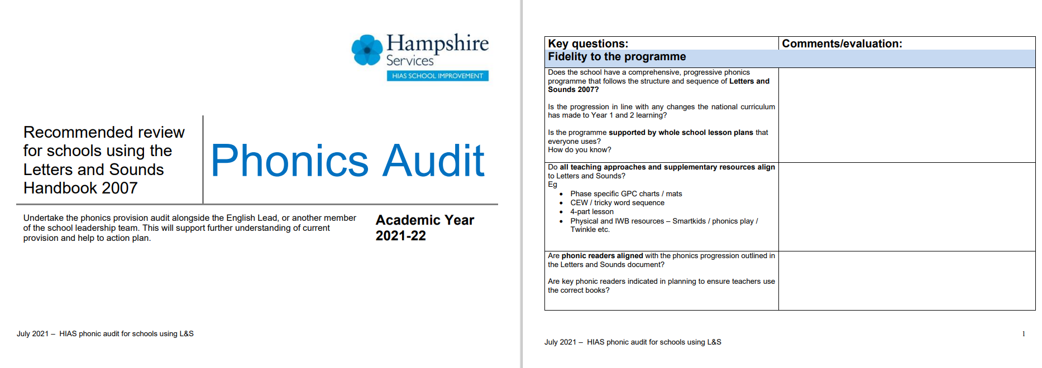
Audit
Our phonics audit tool for Letters and Sounds is freely available on the HIAS English Moodle.

Slide 9
If your ‘programme’ isn’t working for you
If you decide that your school phonics programme requires a radical overhaul and that you wish to align with an SSP, take time to do your research. The validation process will not be completed until Spring 2022.
The SSP programmes will provide a full resource of teaching materials, resources, texts and training so you should wait to ensure you are investing into quality materials.
The title Letters and Sounds is not trademarked and if publishers use it, it must be prefaced with their own name.
‘New’ SSP programmes approved so far are:
Essential Letters and Sounds (OUP books aligned)
Little Wandle Letters and Sounds Revised (Collins books aligned)

Slide 10
Don’t let funding be a barrier
Government scheme to boost core skills
The funding for English will be focused on systematic synthetic phonics, a highly effective method for teaching early reading and an important component in the development of early reading skills, particularly for children from disadvantaged backgrounds.
English Hubs working across the country will allocate funding to eligible primary schools in selected Local Authority Districts and support them to purchase training and resources for one of the phonics programmes on the DfE’s validated list, all of which have been quality assured by an expert panel.
The offer will be rolled out from Autumn term 2021.
Schools that would like to find out more about the funding for English should contact the New Wave English Hub.
https://www.gov.uk/government/news/10-million-scheme-to-help-pupils-boost-core-skills?utm_medium=email&utm_campaign=govuk-notifications&utm_source=c09a4e38-c2de-48a9-8436-c1c5320e5516&utm_content=immediately

Slide 11
Remember, we are here to help
Please contact any member of the HIAS English Team if you would like further advice.
The HIAS English Team were part of the original training programme for Letters and Sounds and still provide up to date training to support schools.

