Slide 1
Year 2
St Peter’s Catholic Primary, Waterlooville

Slide 2
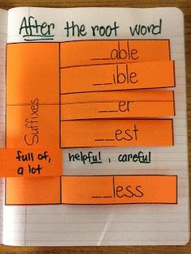
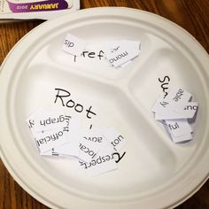
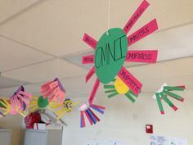
Exploring morphology
Notes:
Un, dis, mis, re, sub, inter, super, anti, auto
ing, ed, er, est, ment, ness, ful, less, ly, ation

Slide 3
Woodcroft Primary, Hampshire

Slide 4
Woodcroft Primary, Hampshire

Slide 5
Woodcroft Primary, Hampshire

Slide 6
Definition of word:
Example word
Focus root word / prefix / suffix:
Meaning:

Slide 7
