Slide 1
Warming up the words
Strategies, games and activities for developing pupils’ vocabulary

Slide 2
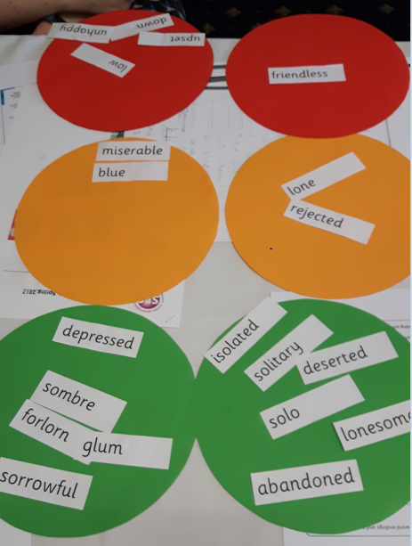
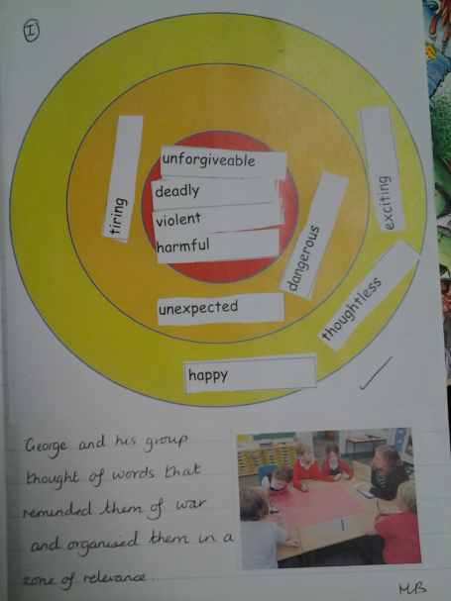
Shades of Meaning
Word Webs
Traffic Light Vocabulary
Zones of Relevance
Best of 3
Odd One Out
Diamond 9
Magpie Walls
‘Cloze’ the gap!
Articulate!
Call my bluff!
Beat the clock – True/False

Slide 3
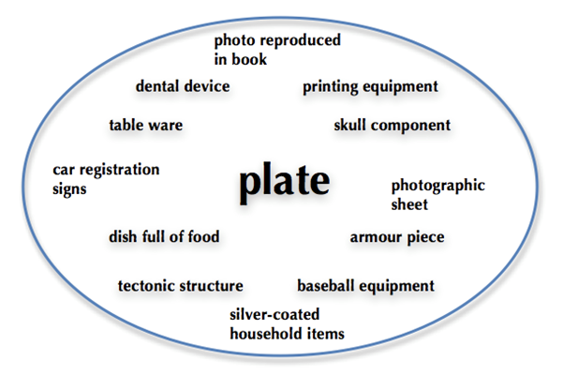
Applause
Making Choices
Semantic Fields
Word Associations
Have you ever..?
Word Sorts
Questions, Reasons and Examples
Would you rather…?
I Spy
I give you this gift…
Teaching Teddy
Alien Definitions
Beanbag categories
Five Things
Scavenger Hunt
Pass the Object
Talking Twins
Bippity Boppety Bumble Bee

Slide 4
Best of 3?
safe
quaint
Idyllic
overlooked
rural
picturesque
private
hidden
isolated
Odd One Out?
Inviting
unspoilt
formal

Slide 5
Articulate!
Teams of 3:
Player one – Describe the key vocabulary in their own words (without saying the actual word)
Player two – guess the word
Player three – Timer and point scorer
Notes:
Words taken from the text Ice Trap!

Slide 6
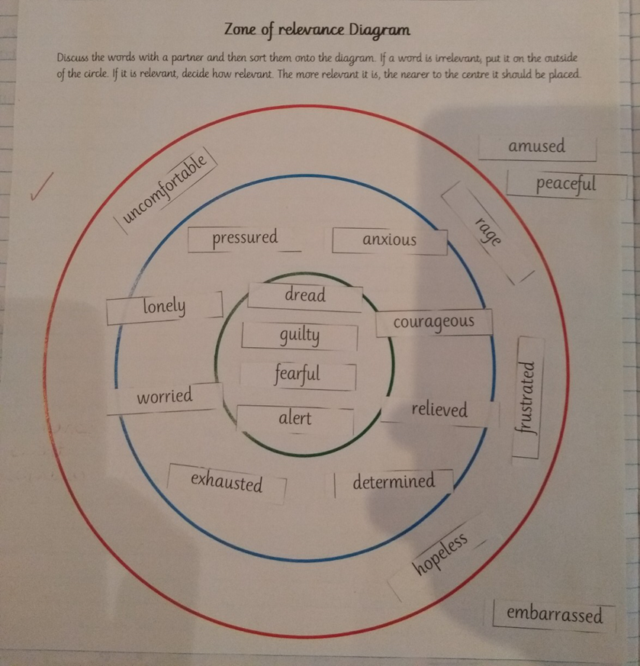

Slide 7
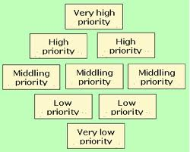
Diamond Nine

Slide 8
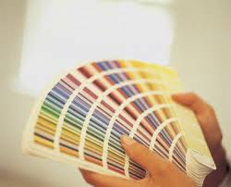
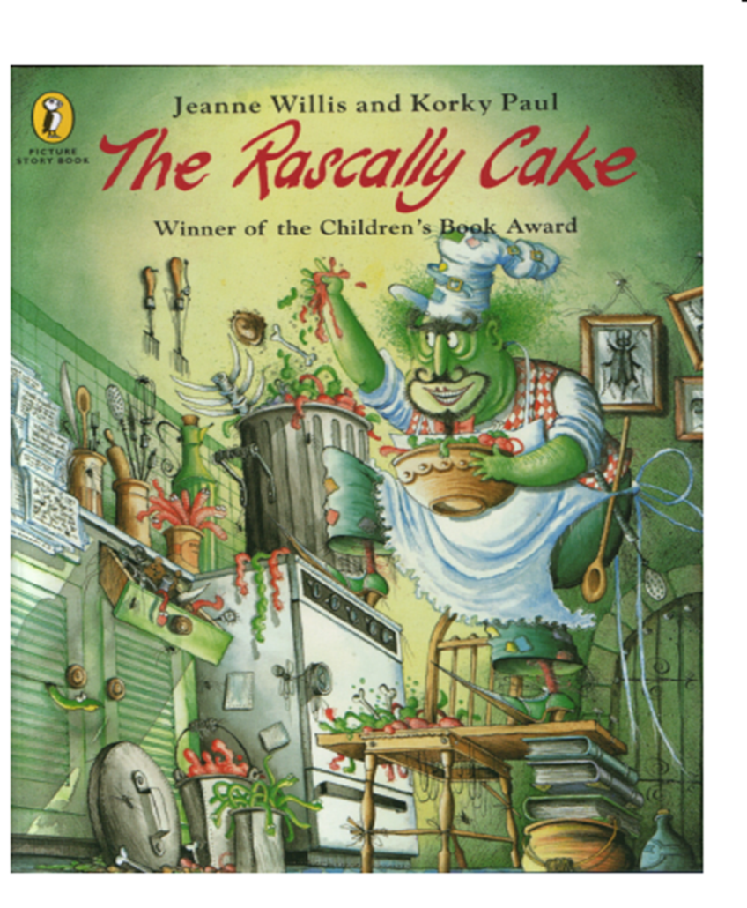
Shades of Meaning – building synonyms of different intensity

Slide 9
Quality storage of vocabulary…7 links (semantic frameworks to store a word)
syllables:
‘Say and clap’
opposite
(antonym)
Meaning:
‘pictoword’
resistance
Synonyms:
same root:
Sentence:
Notes:
Using semantic frameworks to store a word

Slide 10
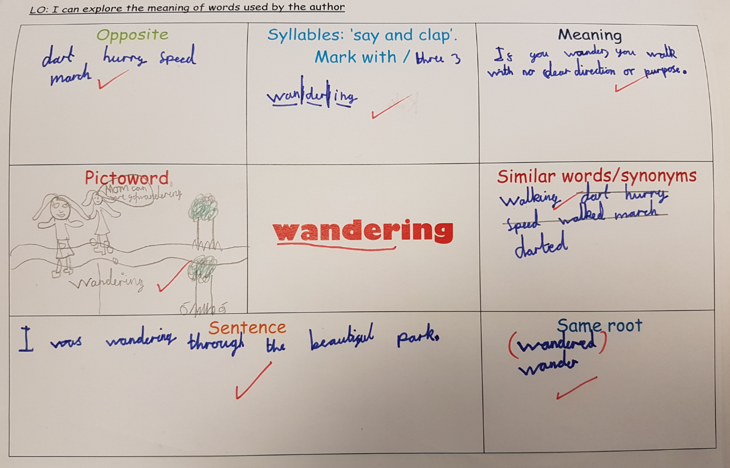

Slide 11
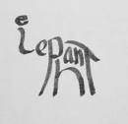
Pictowords/calligrams

Slide 12
A web of associations: What it sounds like
Begins with:
Sound:
Letter:
Rhymes with:
Number of syllables:
Ends with:
Sound:
Letter:

Slide 13
Words that go with it (synonyms):

Slide 14
Develop alternative definitions for words
e.g. Ambitious
1.Really wanting to succeed in becoming rich or important
2. Wanting to get ahead by becoming powerful
3. Wants great success in life
Call My Bluff!

Slide 15
Beat the clock!
True or False?
Shrill sounds can hurt your ears
Regular exercise can elevate stress
The end of year production was a musical cacophony!
Completely submerged, the boy floated on the surface water
Notes:
alleviate

Slide 16
Traffic Light Vocabulary
Red – Words that you know and
Understand and have used in your
writing before
Amber – Words that you know
and understand, but have not used in
your writing before
Green – Words that you don’t know
or understand, and you’ve not used in
your writing before

Slide 17
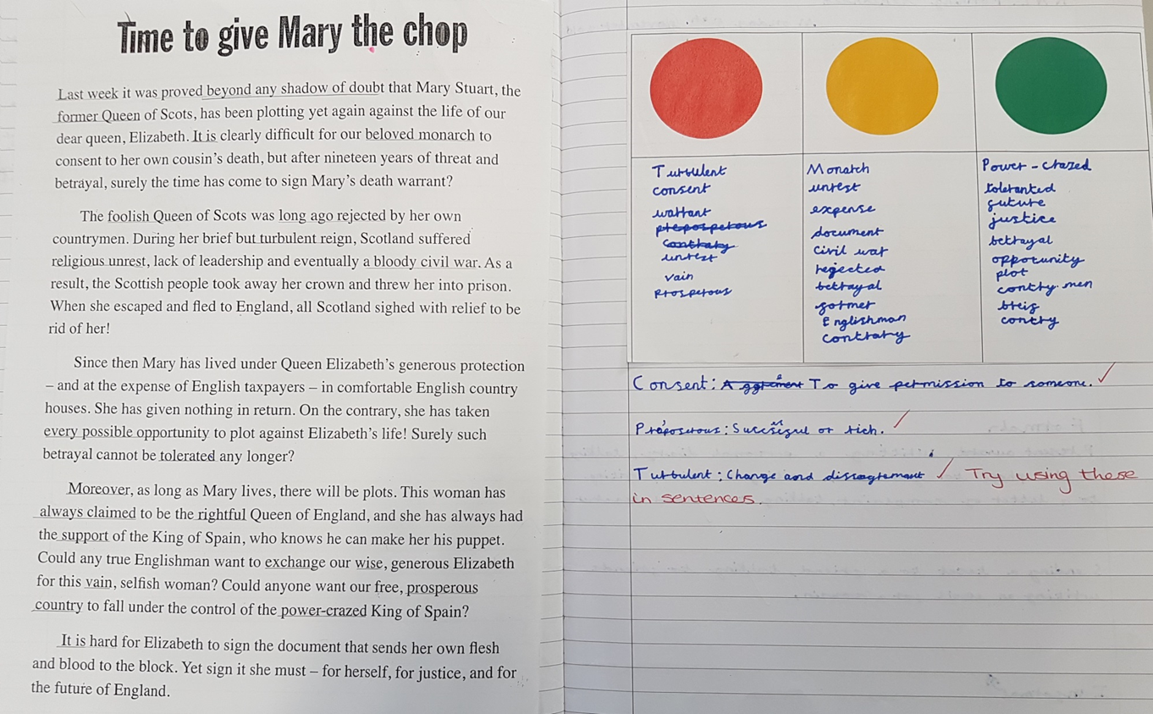

Slide 18
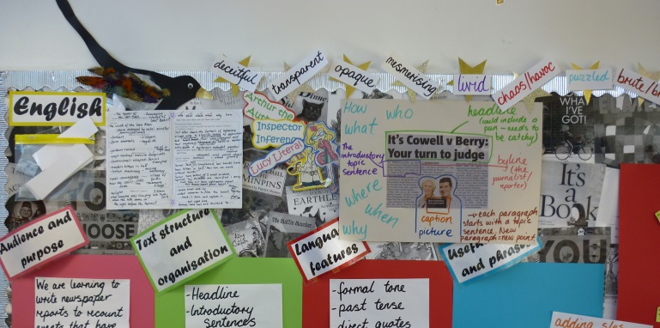
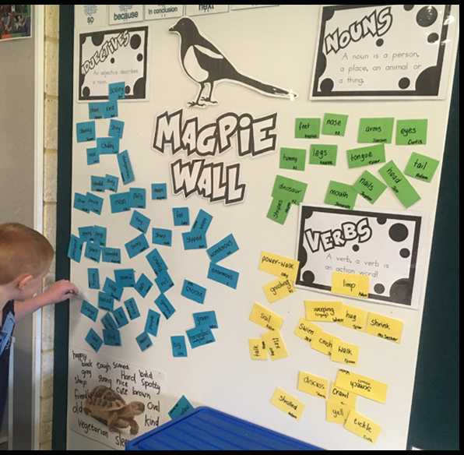
Magpie walls
A class display or part of
the working wall.
A collection of vocabulary that
the children find funny or
interesting or different.
A collection of new, unfamiliar
words
Used across the curriculum

Slide 19
‘Cloze’ the gap!
An effective way to assess starting points:
Can the pupils identify the missing word from the text?
A close synonym would be acceptable as long as it remains contextually accurate.
What would this task be assessing?
Notes:
You would assess: background prior knowledge, vocabulary, reading strategies used to identify missing words

Slide 21
Applause!
Ask children to clap to indicate how much they would like to be described as a ‘target’ word. For example:
frank
astute
vain
stern
impatient
generous
impulsive
gregarious
Notes:
Taken from Bringing Words to Life-Robust Vocabulary Instruction
(Isabel L. Beck, Margaret G McKeown and Linda Kucan)

Slide 22
Making Choices
Ask the children to indicate appropriate examples of the target word being used correctly.
Which of these are examples of people clutching things?
Holding tightly to a purse
Holding a fistful of money
Petting a cat’s fur
Climbing the branches of a tree
Blowing bubbles and catching them
When would you say someone looks radiant?
When they’ve won the lottery
When they have had a ‘selfie’ with their favourite pop star
When they have scored the winning goal in a match
When they are walking home from the post office
When they have just cleaned their room

Slide 23
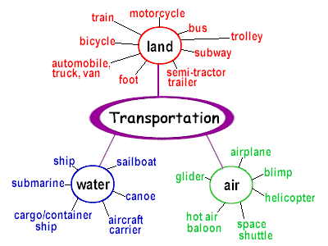
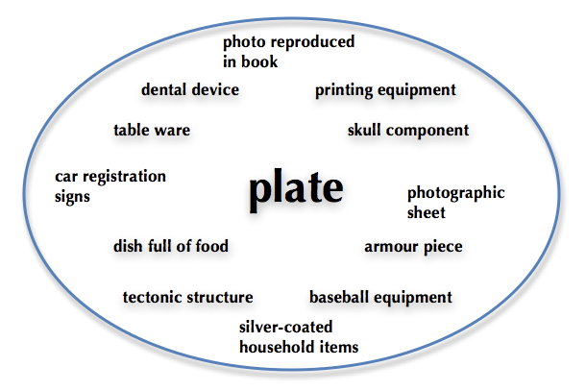
Semantic Fields - Relating Words
Towards the end of a learning journey, it is useful to explore ways in which target words can be linked together. For example, reluctant, anxious and drowsy could all be shown with facial expressions. Tranquil, tepid and distant might all be related when they are used to describe a setting.

Slide 24
Word Associations
When you introduce new words in the same learning journey, you can ask questions that help the children link the word to associated words. For example: accomplice, virtuoso, philanthropist:
Which word goes with crook?
Which word goes with a gift to the hospital?
Which word goes with piano?

Slide 25
Have you ever?
Linking newly learned words to personal experiences. For example, think of an example when you have:
urged someone?
pleaded with someone?
undermined someone?
championed someone?

Slide 26
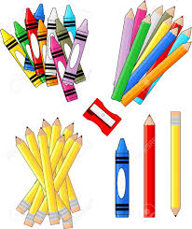
Word Sorts
One way to keep referring back to ‘target’ words throughout the term or year is to provide opportunities for children to ‘sort’ words.
They could sort them in a way of their choosing or you could give them categories:
words that they could use to describe people
words they would use to describe settings
positive words
negative words
neutral words

Slide 27
Questions, Reasons & Examples
Encourage the children to interact with target words by providing and explaining examples of their use and encouraging children to create their own.
For Example:
If you received a letter from a long, lost relative, you might say it was received unexpectedly. When else might something happen unexpectedly?
Tell me about how you might guide someone new around the school. When else might you need to guide someone?
Who of these people might be described as formidable?
a new boss at the office
an inspector
a shy friend
Who else might be formidable?

Slide 28
Would you rather…?
Devise questions around ‘target’ words. For example:
Would you rather anticipate a birthday or a dentist appointment? Why?
Would you rather interact with a shark or a polar bear? Why?
Would you rather confine a butterfly or a cat? Why?

Slide 29
I Spy
Adapt the original game by using adjectives instead. For example:
“I spy something that is spiky, growing, tiny, beautiful.”
Notes:
Early Years Games from Word Aware 2 (Teaching Vocabulary in the Early Years)

Slide 30
I give you a gift…
Place interesting objects in a bag. Explain to the group that they will be choosing a ‘gift’ to give to someone else in the group. They need to describe their gift with an adjective. Model this first. Discuss size, texture or specific attributes.
Use the sentence, ‘I give you this gift because….. it is sparkly.’
Then the child who receives the gift, chooses one for another child.

Slide 31
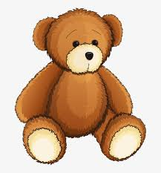
Teach Teddy a New Word
Introduce Teddy and tell the children that he needs help to learn a new word. Ask the children to tell teddy what they know about the word. When they have spoken to teddy, he then summarises what they have said, thus providing a solid definition.
The toy bus is metallic

Slide 32
Alien Definitions
Gather some interesting pictures or objects and an alien puppet. Explain that the alien is trying to learn new things about Earth, and he needs the children’s help. They must describe things to him in full sentences.
Pass the object round, one at a time, and encourage the children to say a sentence, for example:
an elephant is a large animal
an elephant is grey
an elephant has a trunk
an elephant lives in hot countries
At the end, the alien summarises what he has learnt.

Slide 33
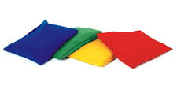
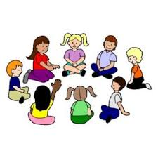
Beanbag Categories
Select a familiar category to the children, for example: animals, beach, toys…
Name an item linked to the category and pass the beanbag on.
Keep going until the group has run out of words.

Slide 34
Five Things
Show children an object or picture. Discuss what you all know about it. When five suitable things have been said, say and act them out together. For example, for astronaut:
“Astronauts can travel in a rocket. Astronauts can walk on the moon. Astronauts can explore outer space. Astronauts can land the spaceship. Astronauts are really smart.”

Slide 35
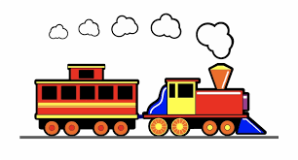
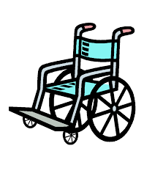
Scavenger Hunt
Ask the children to find objects with given attributes, for example:
it has wheels
it is soft
it is bendy
Then ask the children to compare the objects that they find.

Slide 36
Pass the Object
Find an interesting object that has different features, for example: a toy train or elephant.
Pass the object around and ask each child to say one thing to describe it. For example:
It is soft.
It has wheels.
It runs on a track.

Slide 37
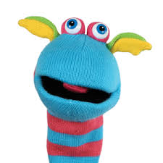
Talking Twins
Introduce a pair of dolls or puppets to the children.
The talking twins ‘sound talk’ their words and finish off each other’s words.
Have a few objects out to label that have only been partially sounded out by the twins, for the children to complete.
t a p
t a

Slide 38
‘Bippity Boppity’ Bumble Bee
Sit a group of children in a circle. The adult holds a toy bee and walks around the circle, stopping at
a child.
Adult: Bippity Boppity Bumble Bee, will you
say a name for me?
Child: Samuel
Adult: Let’s all say it. (The class say the name and clap the syllables.)
Adult: Let’s all whisper it. (Quietly say it and whisper it.)
Everyone: Bippity Boppity Bumble Bee, thank you for saying your name for me!
Repeat with another child. As they become more familiar with the game, adapt it so that they can use topic words e.g. animal names or colours.

